Slide 1









FACETS Support for Coupled
Core-Edge Fusion Simulations
Lois Curfman McInnes
Mathematics and Computer Science Division
Argonne National Laboratory
In collaboration with the FACETS team:
J. Cary, S. Balay, J. Candy, J. Carlsson, R. Cohen, T. Epperly, D. Estep,
R. Groebner, A. Hakim, G. Hammett, K. Indireshkumar, S. Kruger, A. Malony, D. McCune, M. Miah, A. Morris, A. Pankin, A. Pigarov, A. Pletzer,
T. Rognlien, S. Shende, S. Shasharina, S. Vadlamani, and H. Zhang
Notes:
Abstract: Full-device modeling of large test fusion reactors such as ITER requires the self-consistent coupling of codes simulating different physical processes. The multi-institutional FACETS project is developing a multiphysics, parallel application that couples core and edge plasma simulations, along with transport and wall interactions. We will discuss the design of FACETS software, including issues involved in developing concurrent component parallelism, and we will present preliminary results of coupled core-edge simulations.

Slide 2
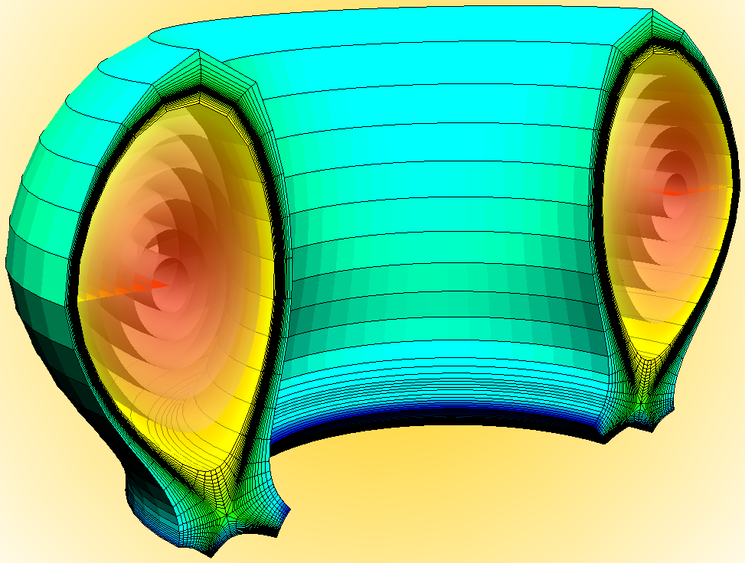
Outline
Motivation
FACETS Approach
Core and Edge Components
Core-Edge Coupling
See also MS50, Friday, Feb 26, 10:50-11:15: John Cary: Addressing Software Complexity in a Multiphysics Parallel Application: Coupled Core-Edge-Wall Fusion Simulations

Slide 3
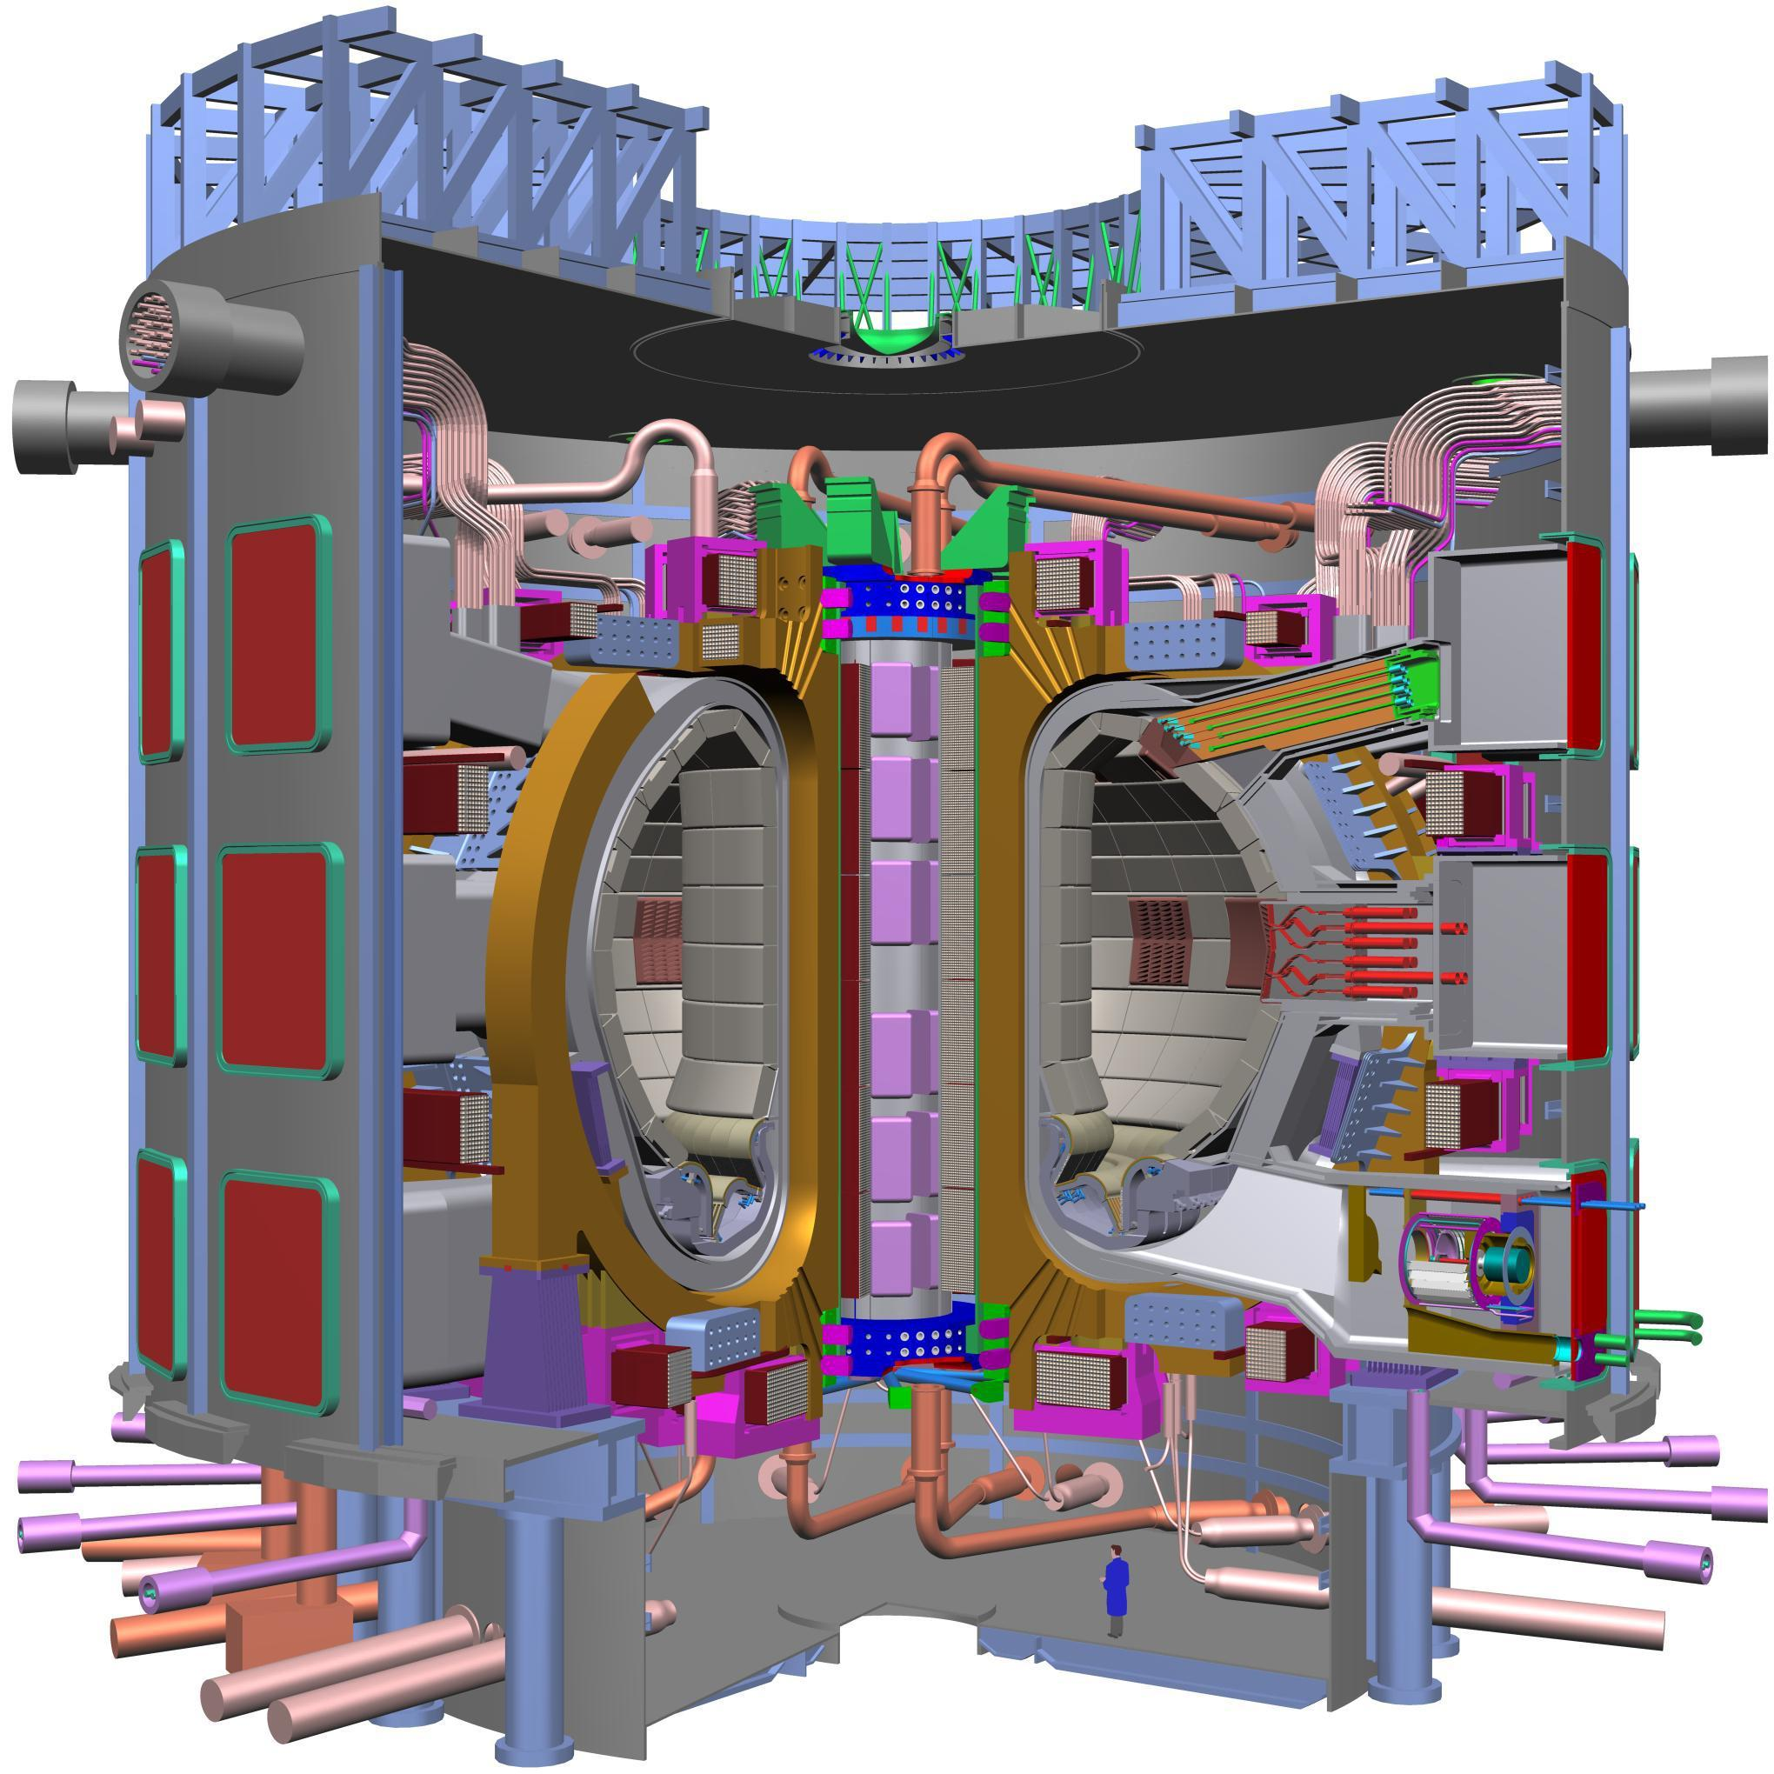
Magnetic fusion goal: Achieve fusion power via the confinement of hot plasmas
Fusion program has long history in high-performance computing
Different mathematical model created to handle range of time scales
Recognized need for integration of models: Fusion Simulation Project, currently in planning stage
Prototypes of integration efforts underway (protoFSPs):
  CPES (PI C. S. Chang, Courant)
  FACETS (PI J. Cary, Tech-X)
  SWIM (PI D. Batchelor, ORNL)
ITER: the world's largest tokamak
Notes:
ITER: The World's Largest Tokamak: ITER is based on the 'tokamak' concept of magnetic confinement, in which the plasma is contained in a doughnut-shape vacuum vessel. The fuel (two Hydrogen isotopes Deuterium (D) and Tritium (T)) is heated to temperatures in excess of 150 million degrees C, forming a hot plasma. Strong magnetic fields are used to keep the plasma away from the walls; these are produced by superconducting coils surrounding the vessel, and by an electrical current driven through the plasma.

Slide 4
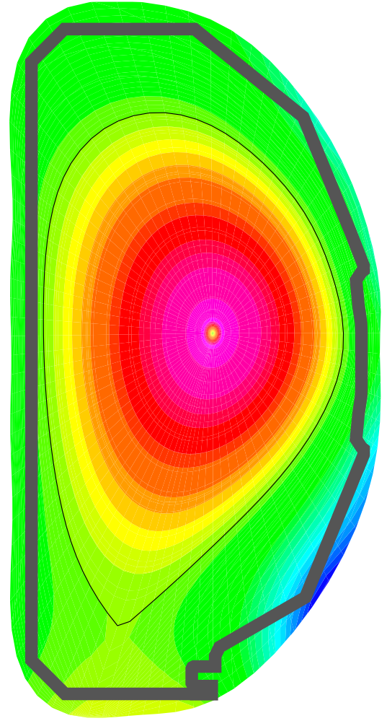
FACETS goal: Modeling of tokamak plasmas from core to wall, across turbulence to equilibrium time-scales
How does one contain plasmas from the material wall to the core, where temperatures are hotter than the sun?
  What role do neutrals play in fueling the core plasma?
  How does the core transport affect the edge transport?
  What sets the conditions for obtaining high confinement mode?
Modeling of ITER requires simulations on the order of 100-1000 sec
Fundamental time scales for both core and edge are much shorter

Slide 5


Acknowledgements
U.S. Department of Energy – Office of Science
Scientific Discovery through Advanced Computing (SciDAC), www.scidac.gov
Collaboration among researchers in
  FACETS (Framework Application for Core-Edge Transport Simulations)
    https://facets.txcorp.com/facets
  SciDAC math and CS teams
    TOPS
    TASCS
    PERI and Paratools
    VACET

Slide 6
FACETS: Tight coupling framework for core-edge-wall
Coupling on short time scales
Inter-processor and in-memory communication
Implicit coupling
Hot central plasma (core): nearly completely ionized, magnetic lines lie on flux surfaces, 3D turbulence embedded in 1D transport
Cooler edge plasma: atomic physics important, magnetic lines terminate on material surfaces, 3D turbulence embedded in 2D transport
Material walls, embedded hydrogenic species, recycling

Slide 7
FACETS will support simulations with a range of fidelity
Leverage rich base of code in the fusion community, including
Core:
  Transport fluxes via FMCFM
  Sources
Edge:
Wall:
GLF23
GYRO
MMM95
TGLF
NCLASS
etc.
NUBEAM
etc.
UEDGE
BOUT++
Kinetic Edge
etc.
WallPSI
etc.

Slide 8
FACETS design goals follow from physics requirements
Incorporate legacy codes
Develop new fusion components when needed
Use conceptually similar codes interchangeably
  No “duct tape”
Incorporate components written in different languages
  C++ framework, components typically Fortran
Work well with the simplest computational models as well as most computationally intensive models
  Parallelism, flexibility required
Be applicable to implicit coupled-system advance
Take maximal advantage of parallelism by allowing concurrent execution

Slide 9
Challenge: Concurrent coupling of components with different parallelizations
Core
  Solver needs transport fluxes for each surface, then nonlinear solve. Domain decomposition with many processors per cell.
  Transport flux computations are one/surface, each over 500-2000 processors, some spectral decompositions, some domain decompositions
  Sources are "embarrassingly parallelizable" Monte Carlo computations over entire physical region
Edge
  Domain decomposed fluid equations
Wall
  Serial, 1D computations
Currently static load balancing among components
  Can specify relative load
  Dynamic load balancing requires flexible physics components

Slide 10
Choice: Hierarchical communication mediation
Core-Edge-Wall communication is interfacial
Sub-component communications handled hierarchially
…
Examples of concurrent simulation support
GYRO
Components use their own internal parallel communication
pattern
Wall (e.g. WallPSI
Edge (e.g.,UEDGE)
Neutral beam sources (NUBEAM)

Slide 11
FACETS Approach: Couple librarified components within a C++ framework
C++ framework
  Global communicator
  Subdivide communicators
  On subsets, invoke components
  Accumulate results, transfer, reinvoke
  Recursive: Components may have subcomponents
Originally standalone, components must fit framework processes
  Initialize
  Data access
  Update
  Dump and restore
  Finalize
Complete FACETS interface available via:
https://www.facetsproject.org/wiki/InterfacesAndNamingScheme

Slide 12
Hierarchy permits determination of component type
FcComponent
FcContainer
FcCoreIfc
FcEdgeIfc
FcWallIfc
FcUpdaterComponent
Concrete implementations of components
FcCoreComponent
FcUedgeComponent
FcWallPsiComponent

Slide 13
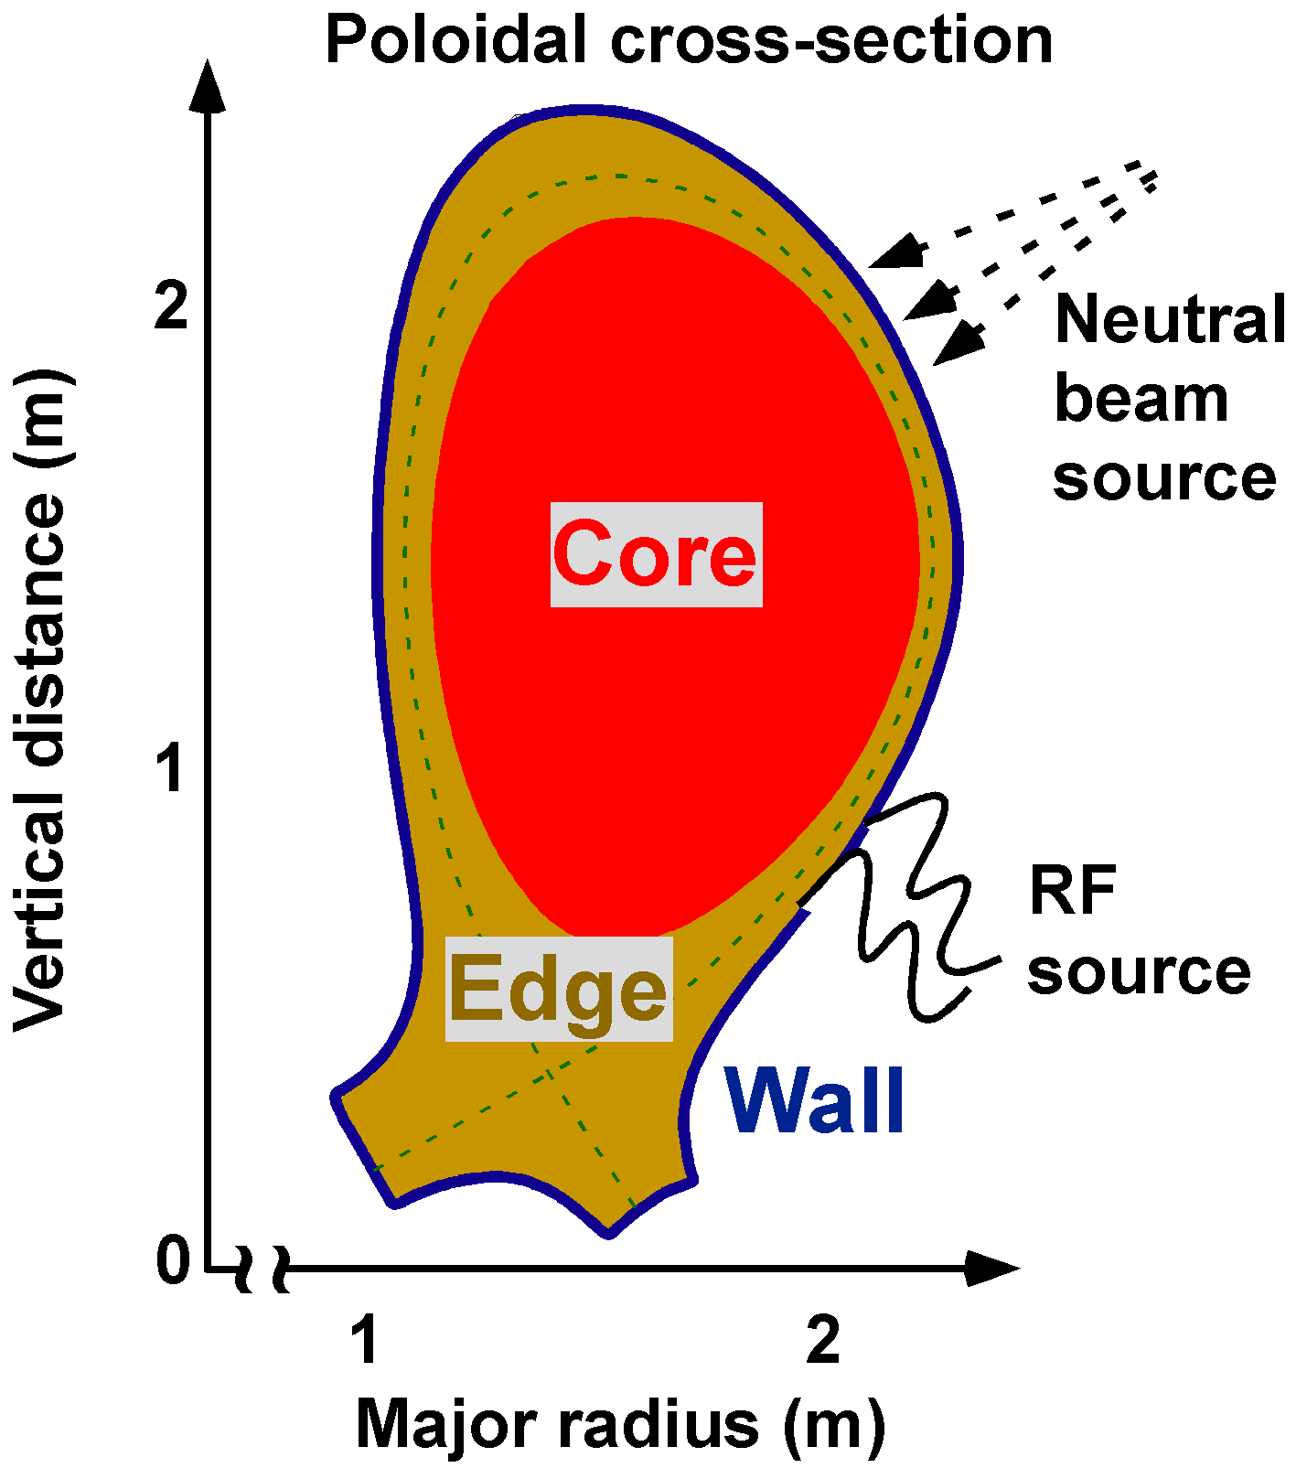
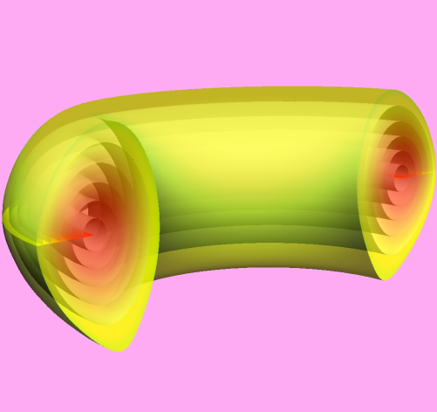
Plasma core: Hot, 3D within 1D
Plasma core is the region well inside the separatrix
Transport along field lines >> perpendicular transport leading to homogenization in poloidal direction
1D core equations in conservative form:
  q = {plasma density, electron energy density, ion energy density}
  F = highly nonlinear fluxes incl. neoclassical diffusion, electron/ion temperature gradient induced turbulence, etc., discussed later
  S = particle and heating sources and sinks

Slide 14
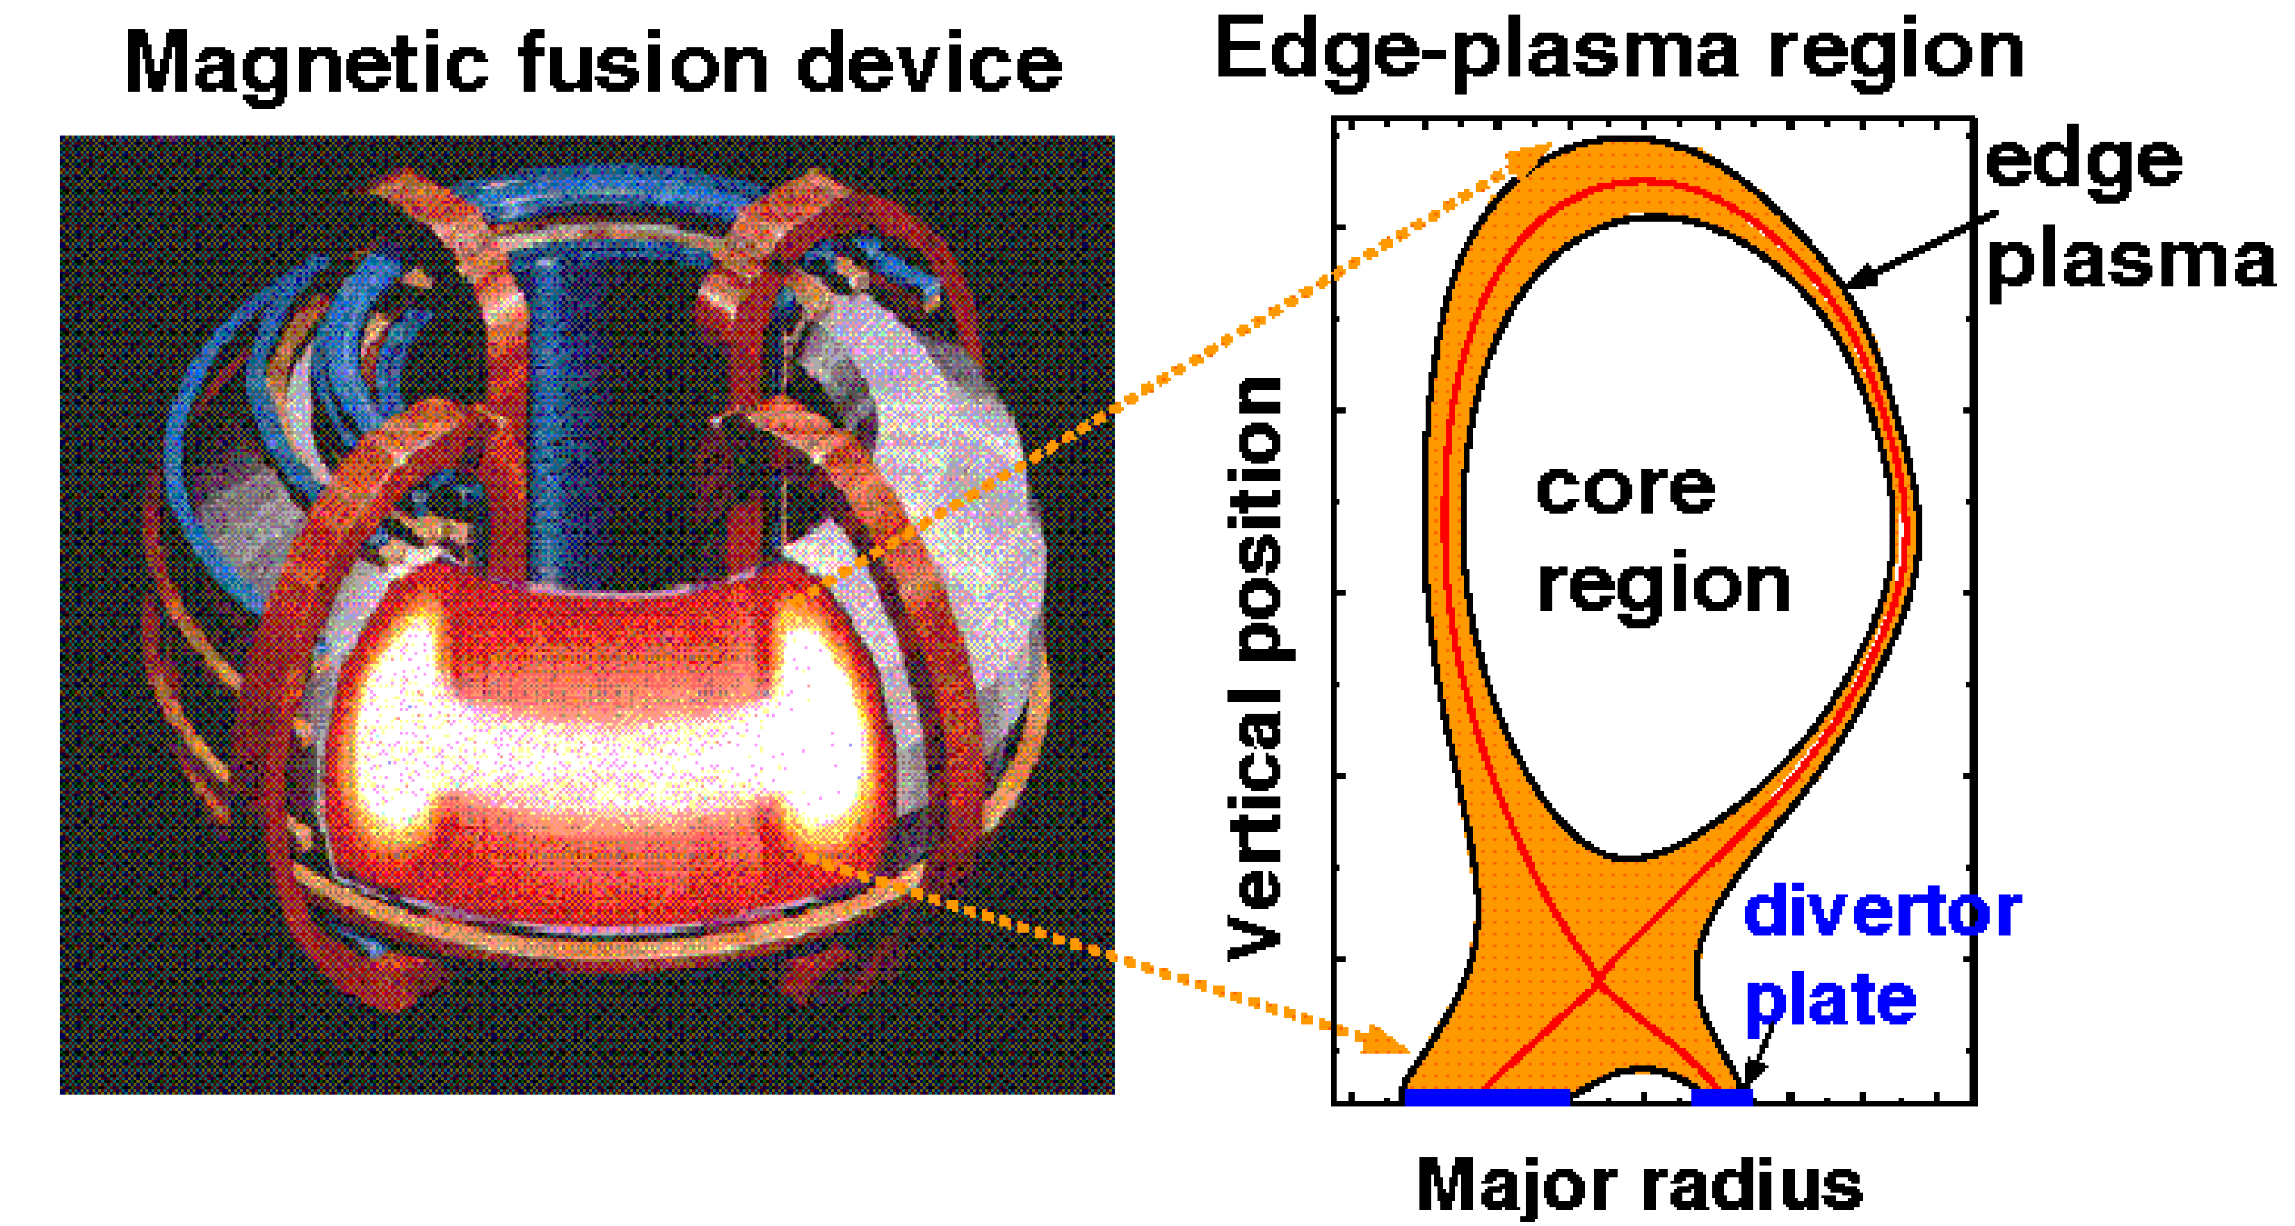
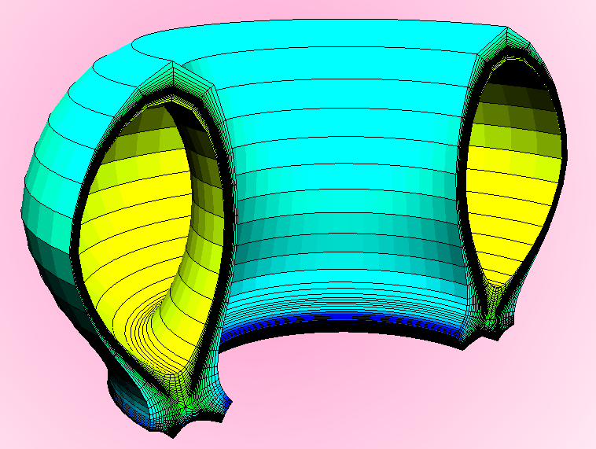
Plasma Edge: Balance between transport within and across flux surfaces
Edge-plasma region is key for integrated modeling of fusion devices
Edge-pedestal temperature has a large impact on fusion gain
Plasma exhaust can damage walls
Impurities from wall can dilute core fuel and radiate substantial energy
Tritium transport key for safety

Slide 15
Nonlinear PDEs in core and edge components
  Core: 1D conservation laws:
  where q = {plasma density,
  electron energy density,
  ion energy density}
  F = fluxes, including neoclassical diffusion, electron and ion temperature, gradient induced turbulence, etc.
  s = particle and heating sources and sinks
  Challenges: highly nonlinear fluxes
  Edge: 2D conservation laws: Continuity, momentum, and
  thermal energy equations for electrons and ions:
  , where & are electron and ion
  densities and mean velocities
  where are masses, pressures, temperatures
  are particle charge, electric & mag. fields
  are viscous tensors, thermal forces, source
  where are heat fluxes & volume heating terms
  Also neutral gas equation
  Challenges: extremely anisotropic transport, extremely strong nonlinearities, large range of spatial and temporal scales
Dominant computation of each can be expressed as nonlinear PDE: Solve F(u) = 0,
where u represents the fully coupled vector of unknowns

Slide 16
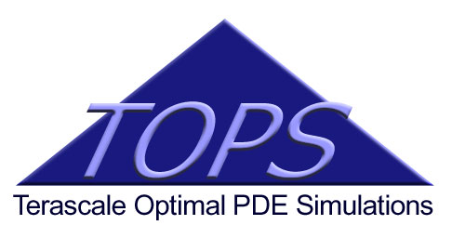
TOPS provides enabling technology to FACETS; FACETS motivates enhancements to TOPS
TOPS develops, demonstrates, and disseminates robust, quality engineered, solver software for high-performance computers
TOPS institutions: ANL, LBNL, LLNL, SNL, Columbia U, Southern Methodist U, U of California - Berkeley, U of Colorado - Boulder, U of Texas – Austin
Towards Optimal Petascale Simulations
PI: David Keyes, Columbia Univ.
www.scidac.gov/math/TOPS.html
Applications
Math
TOPS
TOPS focus in FACETS: implicit nonlinear solvers for base core and edge codes, also coupled systems
CS

Slide 17
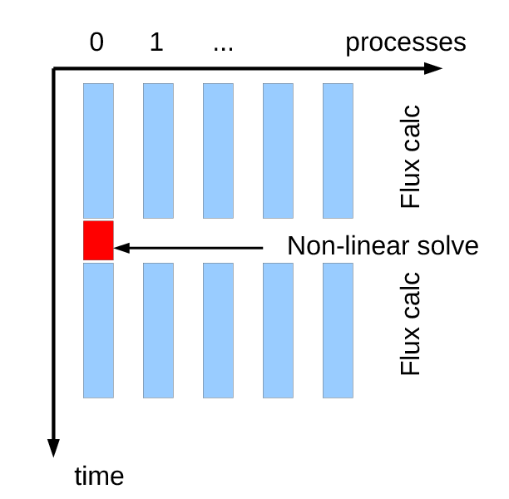
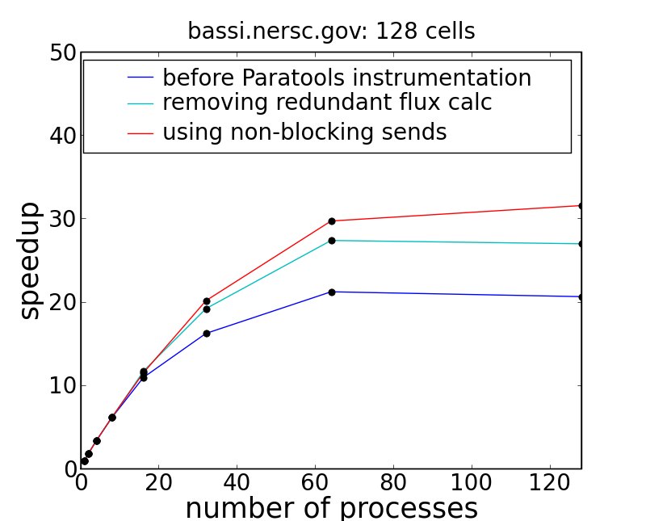
Implicit core solver applies nested iteration with parallel flux computation
New parallel core code, A. Pletzer (Tech-X)
Extremely nonlinear fluxes lead to stiff profiles (can be numerically challenging)
  Implicit time stepping for stability
  Coarse-grain solution easier to find; nested iteration used fine-grain solution
  Flux computation typically very expensive, but problem dimension relatively small
  Parallelization of flux computation across “workers” …“manager” solves nonlinear equations on 1 proc using PETSc/SNES
  Fluxes and sources provided by external codes
Runtime flexibility in assembly of time integrator for improved accuracy
Nonlinear solve

Slide 18
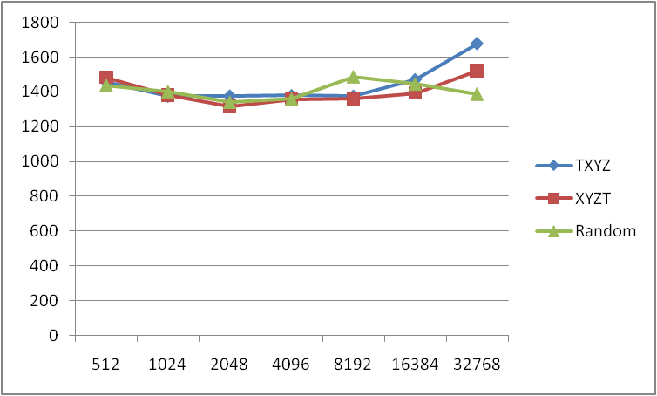
Scalable embedded flux calculations via GYRO
Calculate core ion fluxes by running nonlinear gyrokinetic code (GYRO) on each flux surface
For this instance: 64 radial nodes x 512 cores/radial node = 32,768 cores
Performance variance due to topological setting of the Blue Gene system used here (Paratools, Inc.)
GYRO Ref: J Candy and R Waltz, 2003 JCP, 186 545.

Slide 19
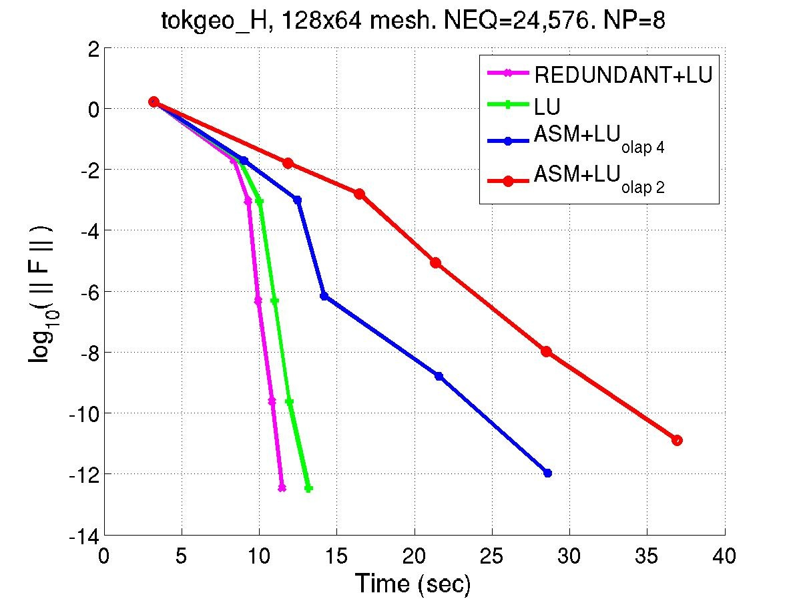
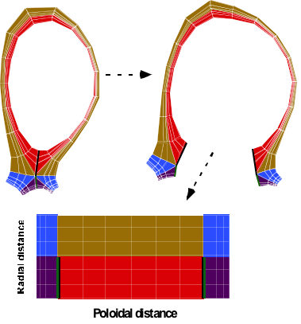
UEDGE: 2D plasma/neutral transport code
UEDGE parallel partitioning
UEDGE Highlights
  Developed at LLNL by T. Rognlien et al.
  Multispecies plasma; variables n_{i,e}, u_{||i,e}, T_{i,e} for particle density, parallel momentum, and energy balances
  Reduced Navier-Stokes or Monte Carlo neutrals
  Multi-step ionization and recombination
  Finite volume discretiz.; non-orthogonal mesh
  Steady-state or time dependent
  Collaboration with TOPS on parallel implicit nonlinear solve via preconditioned matrix-free Newton-Krylov methods using PETSc
    More robust parallel preconditioning enables inclusion of neutral gas equation (difficult for highly anisotropic mesh, not possible in prior parallel UEDGE approach)
    Useful for cross-field drift cases
Notes:
Uedge calculates 2d plasma and neutral gas profiles over long equilibrium scales

Slide 20
Idealized view: Surfacial couplings between phase transitions
Core-edge coupling is at location of extreme continuity
(core equations are asymptotic limit of edge equations)
Mathematical model changes but physics is the same
  Core is a 1D transport system with local, only-cross-surface fluxes
  Edge is a collisional, 2D transport system
Edge-wall coupling
  Wall: beginning of a particle trapping matrix
wall
same points
coupling

Slide 21
Core-edge coupling in FACETS
Initial Approach: Explicit flux-field coupling
  Ammar Hakim (Tech-X)
  Pass particle and energy fluxes from the core to edge
  Edge determines pedestal height (density, temperatures)
  Pass flux-surface averages temperature from edge to core
  Overlap core-edge mesh by half-cell to get continuity
Quasi-Newton implicit flux-field coupling underway
  Johan Carlsson (Tech-X)
  Initial experiments: achieve faster convergence than explicit schemes
FACETS core-edge coupling inspires new support in PETSc for strong coupling between models in nonlinear solvers
  Multi-model algebraic system specification
  Multi-model algebraic system solution

Slide 22
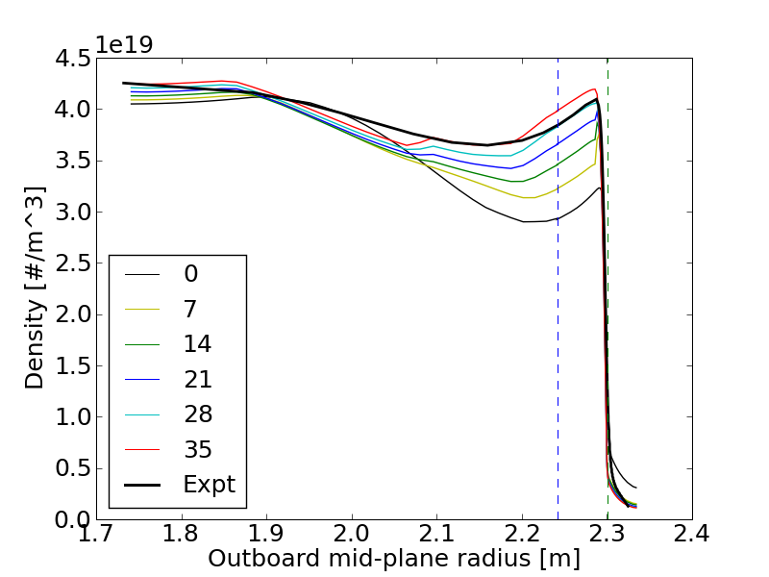
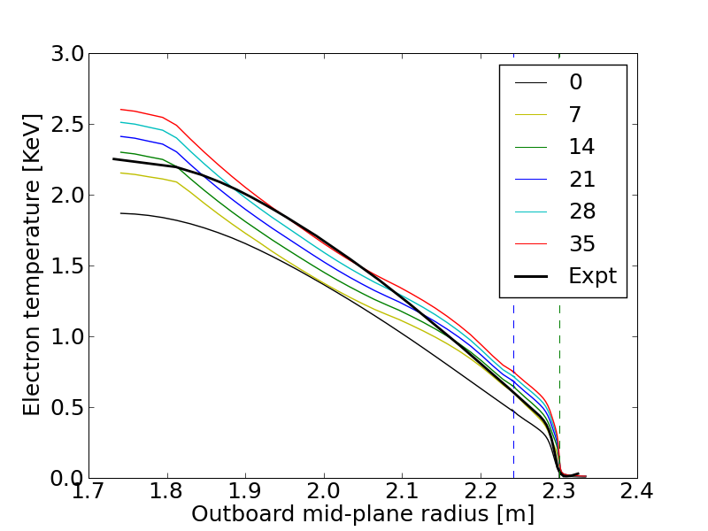
Coupled core-edge simulations of H-Mode buildup in the DIII-D tokamak
Simulations of formation of transport barrier critical to ITER
First physics problem, validated with experimental results, collab w. DIII-D
core
edge
separatrix
Outboard mid-plane radius
Time history of density over 35 ms
Time history of electron temp over 35 ms
separatrix
Notes:
Blue dashed line: core ends, transition from 1D to 2D
Green dashed line: separatrix: last closed flux surface
Right of separatrix: lots of 2D variations; left of separatrix: transition between 1D and 2D behavior

Slide 23
Summary
FACETS has developed a framework for tight coupling
  Hierarchial construction of components
  Run-time flexibility
  Emphasis on supporting high performance computing environments
  Well-defined component interfaces
  Re-using existing fusion components
  Lightweight superstructure, minimal infrastructure
Started validation of DIII-D simulations using core-edge coupling
Work underway in implicit coupling + stability analysis
See also MS50, Friday, Feb 26, 10:50-11:15: John Cary: Addressing Software Complexity in a Multiphysics Parallel Application: Coupled Core-Edge-Wall Fusion SImulations

Slide 24
Extra Slides

Slide 25
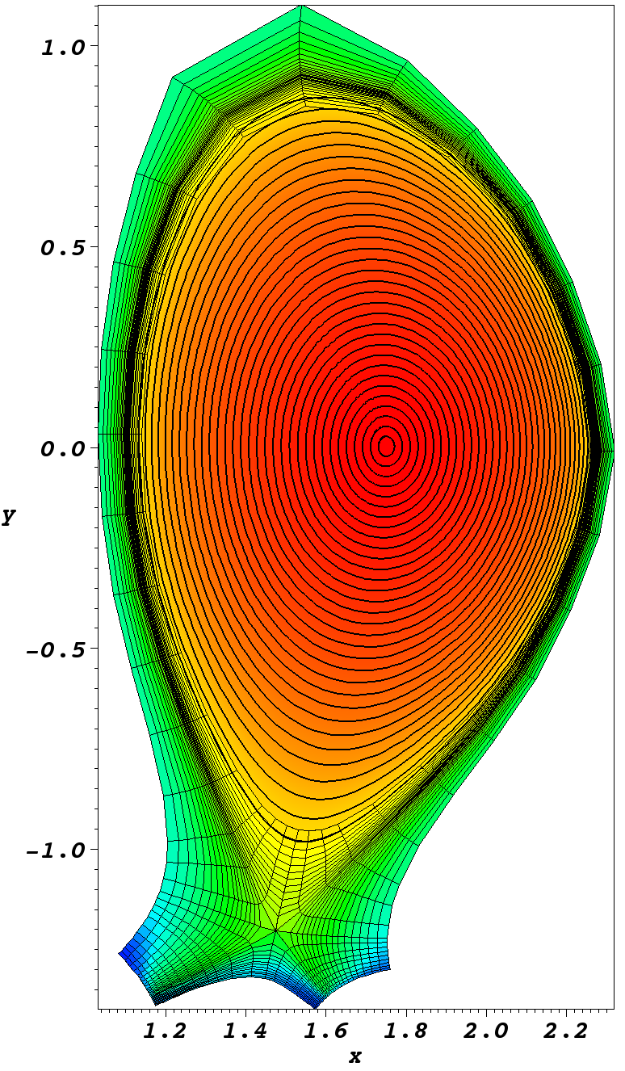
Core-Edge Workflow in FACETS
Computation Visualization
a/g eqdsk
fluxgrid input file
2D geom
file
fluxgrid
core2vsh5
pre file
fragments
pre file
“fit” files
profiles
in 2D
txpp
component
def. files
main
input file
matplotlib, VisIt
FACETS
Black: Fixed form ascii
Green: free-form ascii
Blue: HDF5, VisSchema compliant
Red: Application
component
output files
main
output file
Notes:
The diagram shows the FACETS workflow. The left column shows the computational part of the workflow, and the right shows the visualization part of the workflow.
The computations now typically begin from (fixed form) EQDSK files that contain magnetic data, such as the toroidal and poloidal fluxes, and profile information, such as temperatures and pressures. The fluxgrid code fits a precise equilibrium to this data and outputs flux-surface averaged values for the profiles along with the geometric data needed for solving the profile evolution equations. These are in the form of pre-file fragments, which can be assembled with other run definition data by the txpp preprocessors into the main FACETS input file. The framework reads this file, which contains information on the run, including which components are to be instantiated, and what input files they should read. The output of the simulation are self-describing HDF5 files from the FACETS framework, some of those files having been output by the components.
To visualize the data, the profile data is combined with 2D geometry data by core2vsh5 to get the contours of the profiles in 2D. Edge data is already output in 2D on an unstructured mesh. All of the data is accompanied by VizSchema metadata, so that it is easily interpreted for visualization. For quick line plots, we use matplotlib (with Python). For high-quality visualizations we use VisIt.

