Slide 1
Progress with parallel UEDGE efficiency including time-stepping
Mike McCourt
Hong Zhang
Tom Rognlien
Lois Curfman McInnes

Slide 2
Outline and short summary
Parallel scalability depends on various factors
  Physics Model: With and without neutrals
  Math Model: 1D versus 2D domain decomposition
  Algorithms and Implementation:
    LU (MUMPS) or additive Schwarz preconditioners
    Including time step
Some conclusions
  Parallel multi-step time advance works
  Including neutrals, approach ~5-6 speed-up for NP=8, saturating
  Without neutrals, we don’t see any saturation for NP=8
  Time-step improves convergence/efficiency
  1D decomposition often performs better than 2D

Slide 3
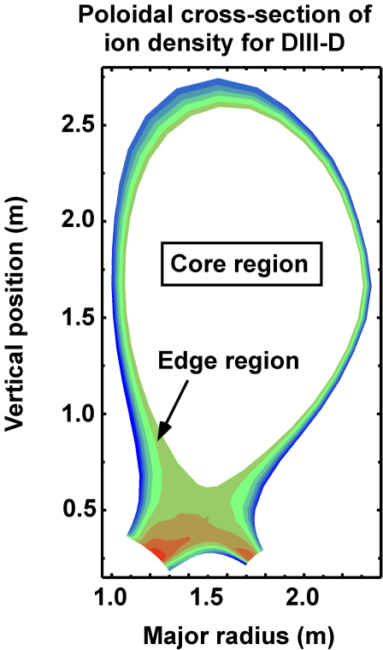
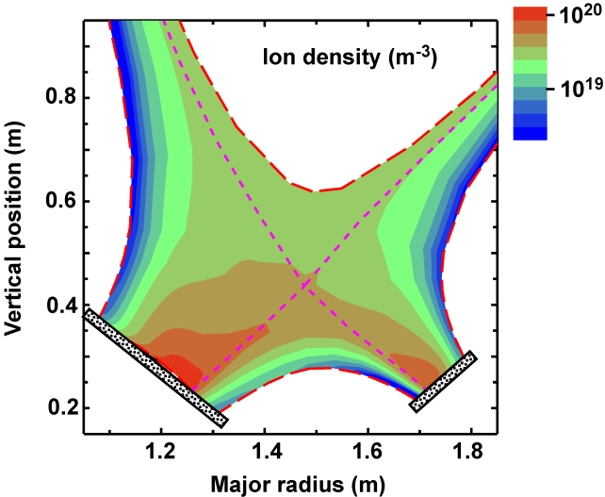
Overview of Physics Model
Magnetic equilibrium for DIII-D single-null tokamak
2D fluid eqns for plasma/neutrals n_{i}, u_{pi}, n_{g}, T_{e}, and T_{i}
Bndry conditions: core – Dirichlet or Neumann; wall/divertor – particle recycling and sheath heat loss
Volumetric Ionization, recombination, and radiation loss

Slide 4
UEDGE Problem Settings
Mesh Size: (poloidal x radial) 64x32 or 128x64
Active Variables: 3 (omit u_{pi}, T_{e}) , 4 (omit n_{g}) or 5 (all)
Time Step: 1 s (~steady-state) or 1e-5 – 1e-2 s (transient)
Domain decomposition: 1D or 2D
Finite-difference preconditioning Jacobian (using PETSc coloring); recomputed every 1 or 5 iterations (lag)
Preconditioner: Enhanced-LU or Additive Schwarz (ASM)
  ASM sub_PC: LU or ILU
  ASM overlap: 0, 1, or higher

Slide 5
Our statement
I imagine this slide needs work
Multistep parallel uedge working successfully
Robust, flexible and efficient solver
  On ITER: Mesh_128x64, lag=1, LUvsASM,
    dt1e-4vs1e-3, 1D domain, NP=1-16, 4 or 5 variables
  On Fusion: Multistepping for Mesh_128x64
    It ran = We’re happy

Slide 6
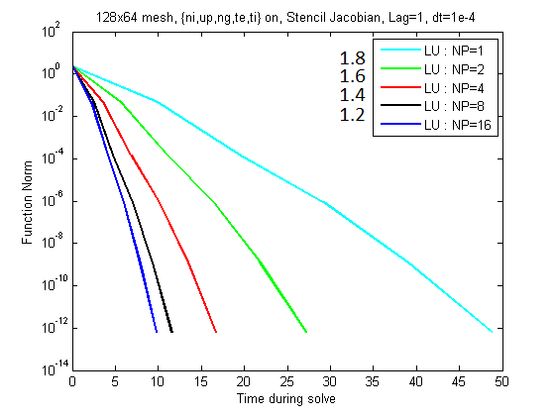
UEDGE runs with NP=16 on iter.txcorp
Note that NP=32 converges, but it takes longer than NP=8 and NP=16. I assume this is because I’m working on a shared resource. If I get a good run at some point I’ll add it in.
Convergence on mesh=128x64, with neutrals activated for NP≤16. iter.txcorp is a shared resource with 4 nodes and 8 cores/node.

Slide 7
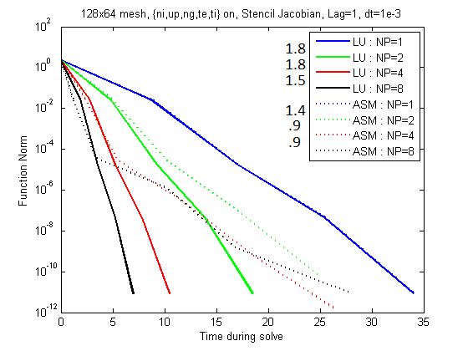
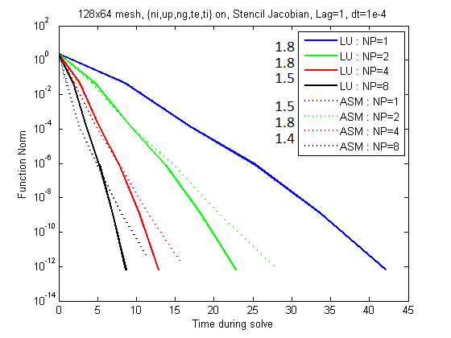
Choice of Δt with Neutrals
Δt = 1e-3
Δt = 1e-4
ASM: Decreasing the time step improves convergence.
LU: Not affected by time step changes.

Slide 8
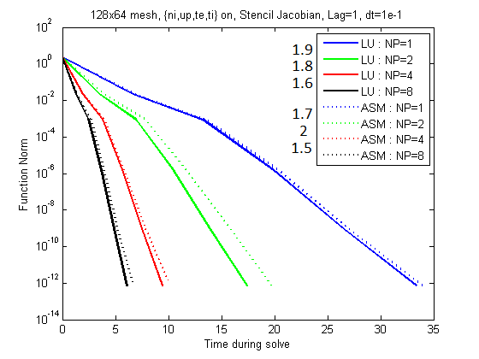
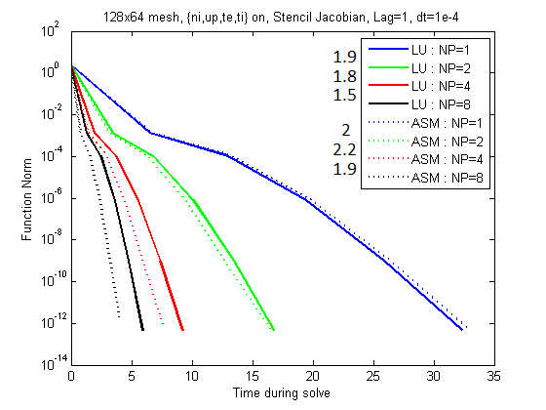
Choice of Δt without Neutrals
Δt = 1e-1
Δt = 1e-4
ASM surpasses LU in efficiency as Δt decreases.

Slide 9
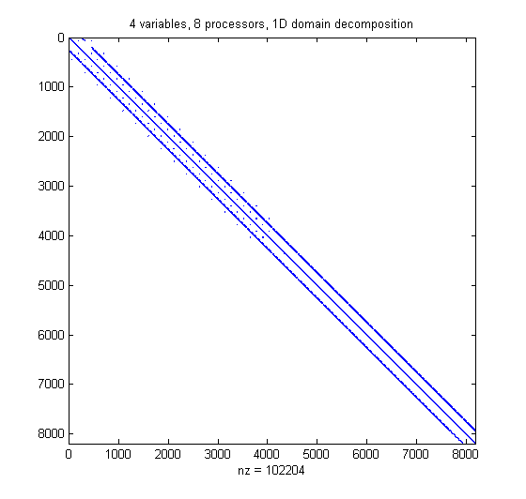
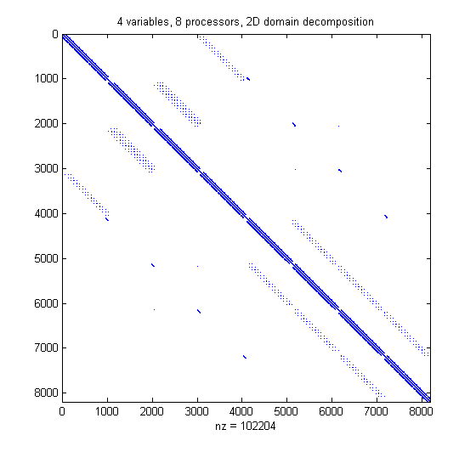
1D vs. 2D domain partition
1D
2D
The different sparsity structure may yield different convergence rates for ASM, since some values are neglected.

Slide 10
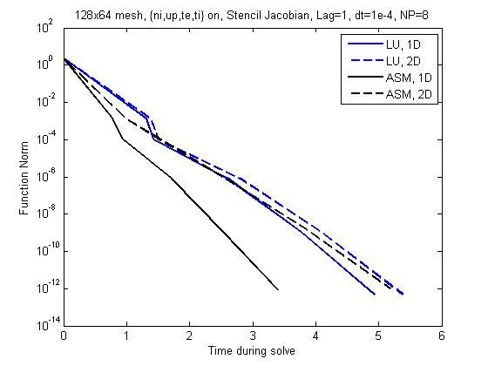
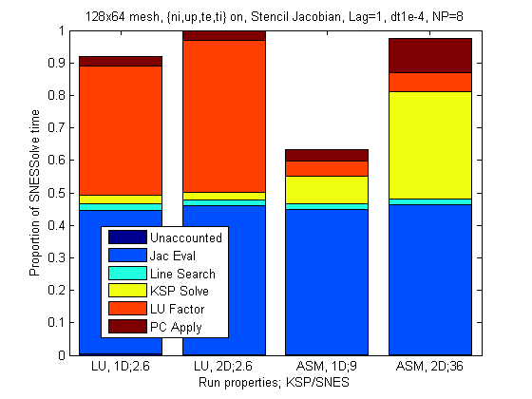
NP=8, Without Neutrals
ASM prefers a 1D domain decomposition without neutrals;
LU slightly prefers 1D, but not as significantly as ASM.

Slide 11
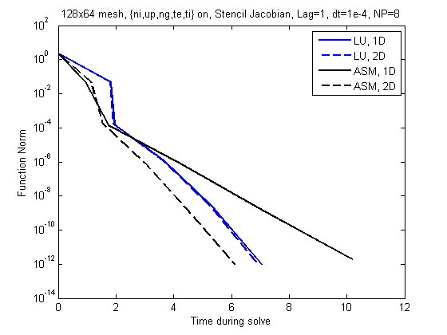
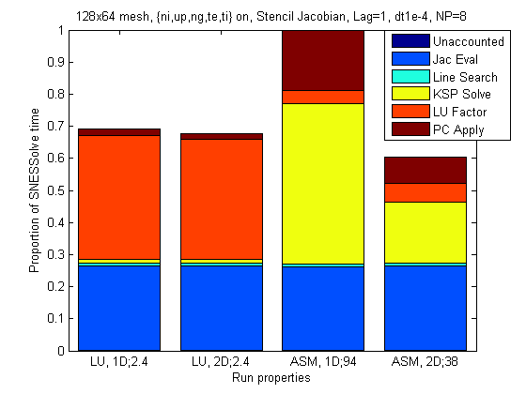
NP=8, With Neutrals
ASM prefers a 2D domain decomposition with neutrals;
LU shows no preference.

Slide 12
Preconditioners (appears later)
We don’t need this slide now
Here will go a comparison of
  LU
  Bjacobi+LU
  ASM+ILU(0)
  ASM+LU
  ASM+LU with overlap 2
This will be with lag=1, dt=1e-4, 4 & 5 vars
Do we want runs with lag=5 in here?

Slide 13
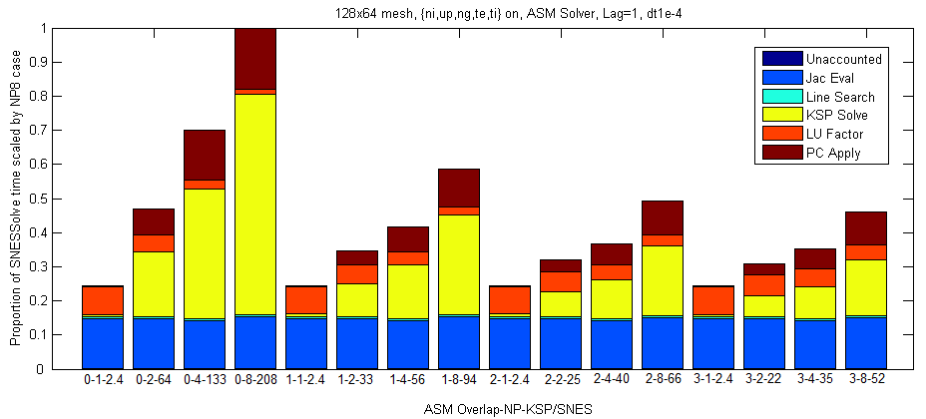
Effect of Overlap
Some overlap is recommended, but improvement is minimal for a small number of processors, or a large overlap.

Slide 14
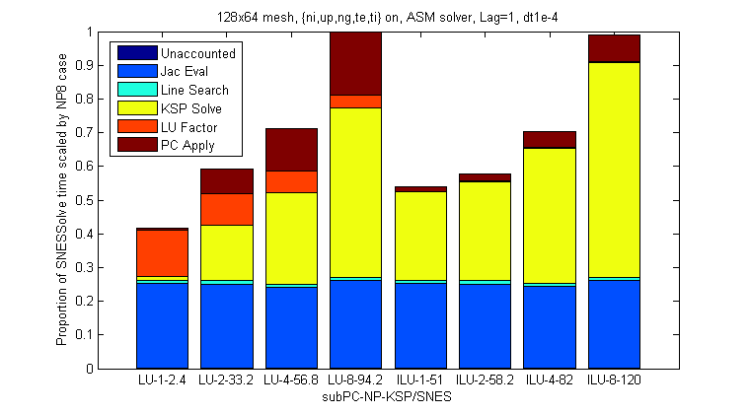
Effect of Solvers on Blocks
LU is preferred for low NP (mid to large block size)
but solvers are equal for higher NP (small block size)
LU: our default

Slide 15
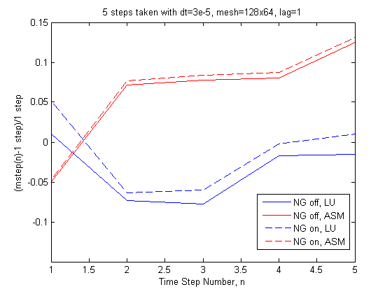
Effect of Multiple Time Stepping
Conducting multiple steps is computationally similar to a single time step; therefore, our analysis on a single time step can be extrapolated to general time stepping.

Slide 16
Exploiting Component Physics
Non Neutral Terms Only
Neutral to Non Neutral
Physics-based
Reordering
Non Neutral to Neutral
Components are Separated
Natural Ordering
Neutral Terms Only
By leveraging our knowledge of the different component physics in the system, we can produce a better preconditioner.
Additive Schwarz,
LU on Blocks
Additive Schwarz gives us scalability
Additive Componentwise Preconditioner
LU handles the block that ASM cannot
Full LU Solve

Slide 17
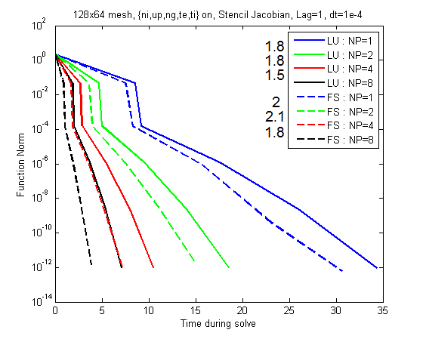
Physics Preconditioning
Scalability for LU: 1.8x1.8x1.5 = 4.86
Scalability for FS: 2.0x2.1x1.8 = 7.56

Slide 18
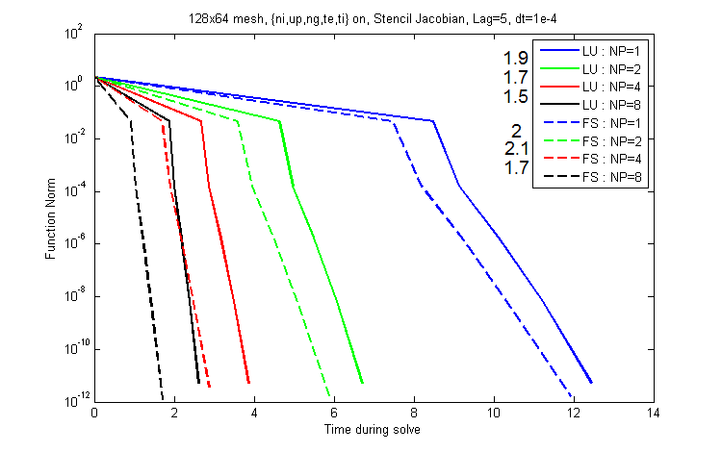
Physics Preconditioning
Even without reevaluating the Jacobian, we can see the physics preconditioner outperforms the full decomposition.

Slide 19
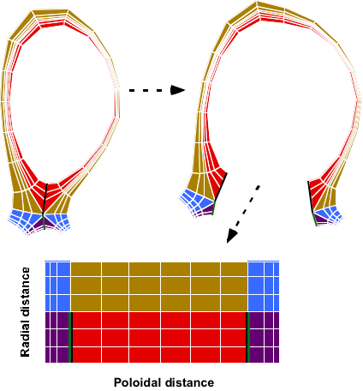
UEDGE computations are done on a 2D logically-rectangular mesh; facilitates parallel decomposition
Physical mesh is based on magnetic flux surfaces (here DIII-D)
Code algorithms treat problem on a rectangular domain with mapping as shown
Z
R

Slide 20
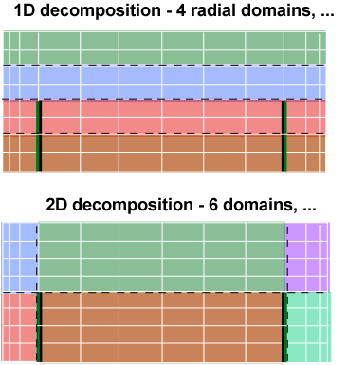
For parallel computations, either 1D or 2D decomposition can be utilized
1D radial decomposition can use serial code logic in the poloidal direction (i.e., non-local indexing around poloidal cuts)
2D decomposition uses domains with edges at poloidal cuts to eliminate non-local indexing

Slide 21
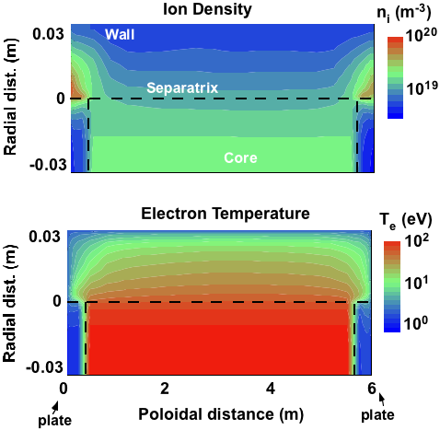
Typical solutions exhibit range edge phenomena, e.g., plate recycling and parallel heat conduction
Ions recycle as neutral gas at the divertor (lower surface) to increase plate plasma density
Electron heat loss at the divertor and ionization losses decreases plate plasma temperature

