Slide 1
OSR
My details:
-> Aditya kiran
->Grad-1st year
Applied Math
->UnderGrad-
Major in Information technology

Slide 2
HILBERT’S 23
PROBLEMS

Slide 3
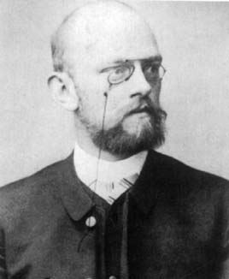
Hilbert’s 23 problems
David Hilbert was a German mathematician .
He published 23 problems in 1900.
They were all unsolved at that time and were quite important for 20th century Mathematics.
He was also a physicist..
Hilbert spaces named after him
Co-discoverer of general relativity..

Slide 4

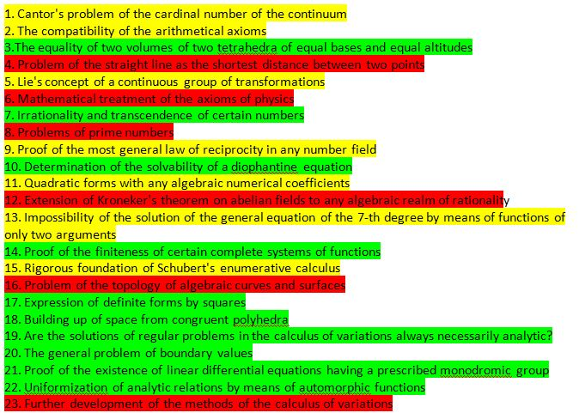
SOLVED
PARTIALLY RESOLVED
UNSOLVED

Slide 5
All these questions and topics are highly researched since the last 100 years.
So it might be difficult to understand some of them without pre-knowledge.
So, I wil try to convey whatever I’d understood.

Slide 6
1. Cantor's continuum hypothesis
PARTIALLY SOLVED
“There is no set whose cardinality is strictly between that of the integers and that of the real numbers”
Cardinality is the number of elements of a set.
But when it comes to finding the size of infinite sets,
the cardinality can be a non-integer.
The hypothesis says that the cardinality of the set of integers is strictly smaller than that of the set of real numbers
So there is no set whose cardinality is between these two sets.

Slide 7
2. Consistency of arithmetic axioms
PARTIALLY SOLVED
In any proof in arithmetic, Can we prove that all the assumptions and statements are consistent?
Is arithmetic free of internal contradiction.?

Slide 8
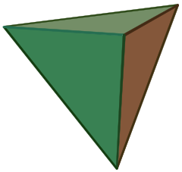

3. Polyhedral assembly from polyhedron of equal volume
SOLVED
Given 2 polyhedra of same volume.
Now the 1st one is broken up into finitely many parts.
Now Can we join those broken parts to form the 2nd polyhedron.??
i.e Can we decompose 2 polyhedron identically? NO!!

Slide 9
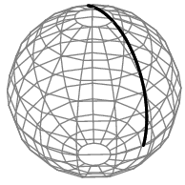
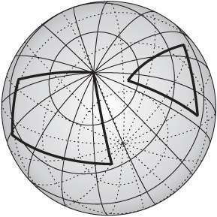
4. Constructibility of metrics by geodesics
PARTIALLY SOLVED
Construct all metrics where the lines are geodesics.
Geodesics are straightlines on curves spaces.
Find geometries on geodesics whose axioms are close to euclidean geometry(with the parallel postulate removed.etc)
Solved by G. Hamel.

Slide 10
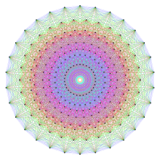
5. Are continuous groups automatically differential groups?
PARTIALLY SOLVED
Existence of topological groups as manifolds that are not differential groups.
Is it always necessary to assume differentiability of functions while defining continuous groups?
NO.!..
A Lie group

Slide 11
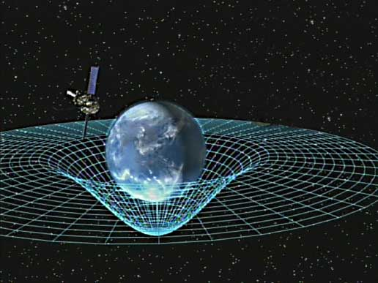
6. Axiomatization of physics
NOT SOLVED
Mathematical treatment of the axioms of physics.
Says that all physical axioms and theories need a strong mathematical framework.
It is desirable that the discussion of the foundations of mechanics be taken up by mathematicians also.
Eg:
  A point is an object without extension.
  Laws of conservation (Δε(a,b) = ΔK(a,b) + ΔV(a,b) = 0)
  The total inertial mass of the universe is conserved…etc
  Time is quantized

Slide 12
7. Genfold-Schneider theorem
SOLVED
Is a^{b} transcendental, for algebraic a ≠ 0,1 and irrational algebraic b ?
YES.!!
Transcendental number=>
-not algebraic
-not a root of polynomial with rational coeffs.
Eg: ∏,e..etc

Slide 13
8. Riemann hypothesis
NOT SOLVED
Reg the location of non-trivial roots of the Riemann-zeta function.
Riemann said that, ”the real-part of the non-trivial roots is always =1/2”
This has implications on:
-Prime number distribution
-Goldbach conjecture

Slide 14
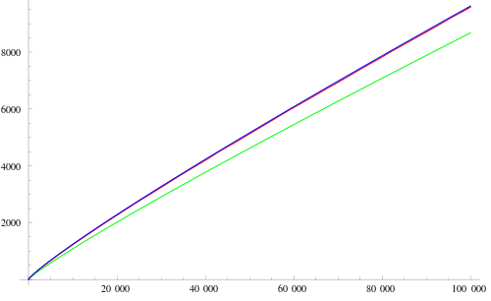
On Prime numbers:
Riemann proposed that the magnitudes of oscillation of primes around their expected position is controlled by the real-part of the roots of the zeta function.
Prime number thrm=> :- ∏(x)

Slide 15
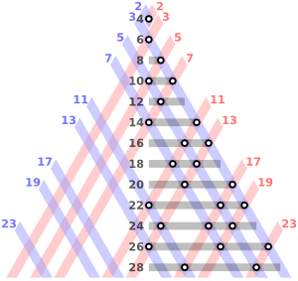
GoldBach conjecture:
Every even integer greater than 2 can be expressed as sum of two primes

Slide 16


9. Algebraic number field reciprocity theorem
PARTIALLY SOLVED
Find the most general law of reciprocity thrm in any algebric number fields.
Eg: quadratic reciprocity:
p,q are distinct odd no.s

Slide 17
10. Matiyasevich's theorem Solved
SOLVED
Does there exist some algorithm to say if a polynomial with integer co-effs has integer roots?
Does there exist an algorithm to check if a diophantine equation can have integer co-effs.
-Diophantine eqn is a polynomial that takes only integer values for variables

Slide 18
11. Quadratic form solution with algebraic numerical coefficients
PARTIALLY SOLVED
Solving quadratic forms with Algebric numeric co-efficients .
Improve theory of quadratic forms like ax²+bxy+cy² .,etc

Slide 19
12. Extension of Kronecker's theorem to other number fields
NOT SOLVED
Extend Kronecker's problem on abelian extensions of rational numbers.
Statement:
“ every algebraic number field whose Galois group over Q is abelian, is a subfield of a cyclotomic field “

Slide 20
13. Solution of 7th degree equations with 2-parameter functions
PARTIALLY SOLVED
Take a general 7th degree equation x⁷+ax³+bx²+cx+1=0.
Can its solution as a function of a,b,c be expressed using finite number of 2-variable functions
Can every continuous function of three variables be expressed as a composition of finitely many continuous functions of two variables

Slide 21
14. Proof of finiteness of complete systems of functions
SOLVED
Are rings finitely generated?
Is the ring of invariants of an algebraic group acting on a polynomial ring always finitely generated?

Slide 22
15. Schubert's enumerative calculus
PARTIALLY SOLVED
Require a rigorous foundation of Shubert’s enumerative calculus.
enumerative calculus=> counting problem of projective geometries

Slide 23
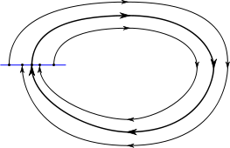
16. Problem of the topology of algebraic curves and surfaces
NOT SOLVED
Describe relative positions of ovals originating from a real algebraic curves as a limit-cycles of polynomial vector field.
Limit cycle

Slide 24
17. Problem related to quadratic forms
SOLVED
Given a multivariate polynomial that takes only non-negative values over the reals, can it be represented as a sum of squares of rational functions?
A rational function is any function which can be written as the ratio of two polynomial functions
Eg:

Slide 25
18. Existence of space-filling polyhedron and densest sphere packing
SOLVED
The 18th question asks 3 questions:
a)Symmetry groups in n-dimensions
Are there infinitely many essential sub-groups in n-D space?
b)Anisohedral tiling in 3 dimensions
Does there exist an anisohedral polyhedron in 3D euclidean space?
c)Sphere packing

Slide 26
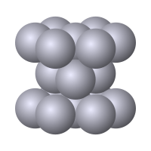

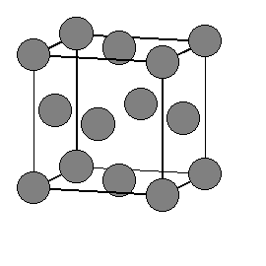

Slide 27

19. Existence of Lagrangian solution that is not analytic
SOLVED
Are the solutions of lagrangians always analytic.?
  YES

Slide 28
20. Solvability of variational problems with boundary conditions
SOLVED
Do all boundary value problems have solutions.?

Slide 29
21. Existence of linear differential equations with monodromic group
SOLVED
Proof of the existence of linear differential equations having a prescribed monodromic group
monodromy is the study of how objects from mathematical analysis, algebraic topology and algebraic and differential geometry behave as they 'run round' a singularity

Slide 30
22. Uniformization of analytic relations
SOLVED
It entails the uniformization of analytic relations by means of automorphic functions.

Slide 31
23. Calculus of variations
NOT SOLVED
Develop calculus of variations further.
The 23rd question is more of an encouragement to develop the theory further.

Slide 32
So these were the 23 problems that Hilbert had proposed for the 20th century mathematicians..

Slide 33
Apart from these there are another class of problems called the ‘’Millenium problems’’
A set of 7-problems
Published in 2000 by Clay Mathematics Institute.
Only 1 out of 7 are solved till date.
1
7

Slide 34
The seven Millenium problems are:
P versus NP problem
Hodge conjecture
Poincaré conjecture ----(solved)
Riemann hypothesis
Yang–Mills existence and mass gap
Navier–Stokes existence and smoothness
Birch and Swinnerton-Dyer conjecture

Slide 35

Poincaré conjecture
Statement:
“ Every simply connected, closed 3-manifold is homeomorphic to the 3-sphere.”
Grigori Perelman , a Russian mathematician it solved in 2003
He was selected for the Field prize and
the Millenium prize.
He declined both of them,
saying that he is not interested
In money or fame

Slide 36
Thank you

