Slide 1
A GLIMPSE ON FRACTAL GEOMETRY
YUAN JIANG
Department of Applied Math
Oct9, 2012

Slide 2
Brief
Basic picture about Fractal Geometry
Illustration with patterns, graphs
Applications(fractal dimensions, etc.)
Examples with intuition(beyond maths)
Three problems related, doable for us

Slide 3
0. History
Mandelbrot(November 1924 ~ October 2010),
Father of the Fractal Geometry.
For his Curriculum Vitae, c.f. http://users.math.yale.edu/mandelbrot/web_docs/VitaOnePage.doc

Slide 4
1.1 Definition
Fractal Geometry-----
concerned with irregular patterns made of parts that are in some way similar to the whole, called self-similarity.

Slide 5
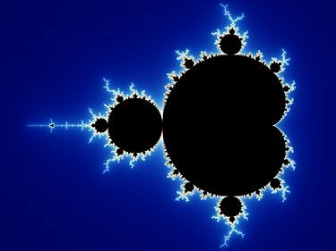
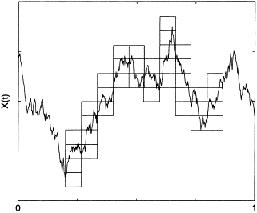
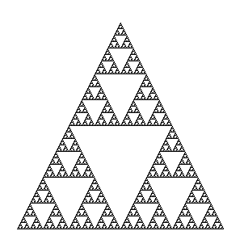
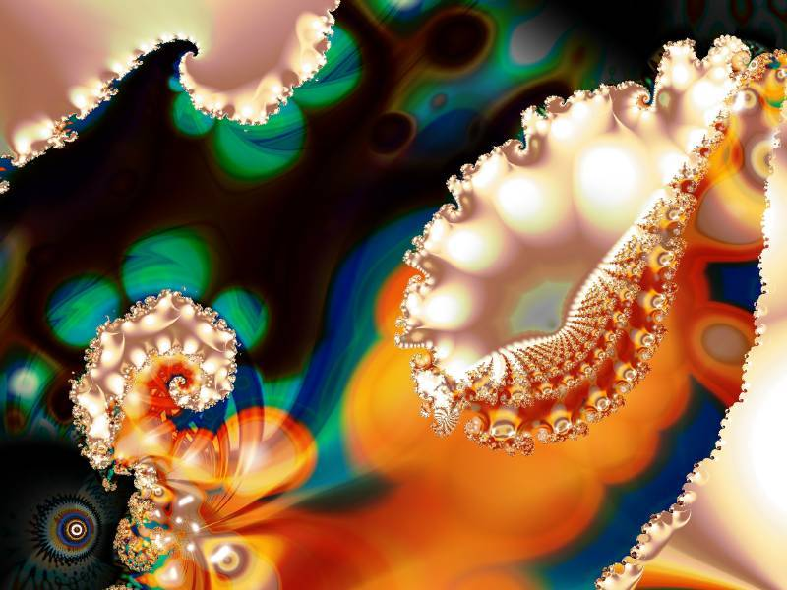
1.2 Illustration

Slide 6
2.1 What’s behind the curve?
Geometric properties----
lengths/areas/volumes/…
Space descriptions----
dimensions(in what sense?)/…

Slide 7
2.2 Fractal dimensions
Dimension in various sense
----concrete sense
----parameterized sense
----topological sense
----……
Fractal dimensions
(for regular fractal stuffs)
Hausdorff Dimension
‘MEASURING
&
ZOOMING’
(See the Whiteboard)

Slide 8
2.3 Formula of fractal dimension (for regular fractal geometry)
Let k be the unit size of our measurement (e.g. k=1cm for a line), with the method of continuously covering the figure; let N(k) be the # of units with such a measurement method.
Then, the Hausdorff dimension of fractal geometry is defined as
D=lnN(k)/ln(1/k)

Slide 9
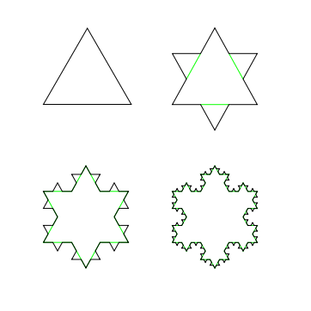
2.4 Fractal Dimensions(examples)
Koch Snowflake (1-D)
D=ln4/ln3=1.262
Sierpinski Curtain (2-D)
D=ln3/ln2=1.585
Menger Sponge (3-D)
D=ln20/ln3=2.777

Slide 10
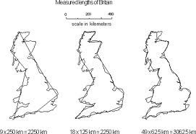
3.1 Applications in Coastline Approximation
Think about coastlines, and what’s the dimension? 1? 2? Or some number in between?
(See Whiteboard)
Notice: it’s no longer regular.

Slide 11
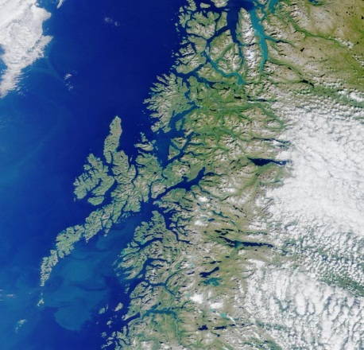
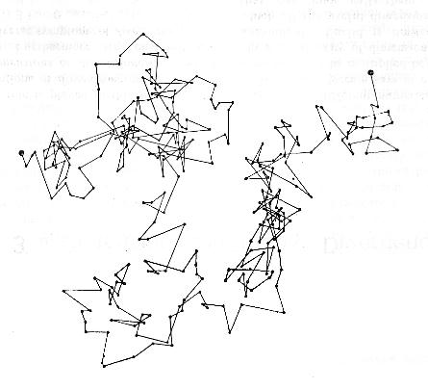
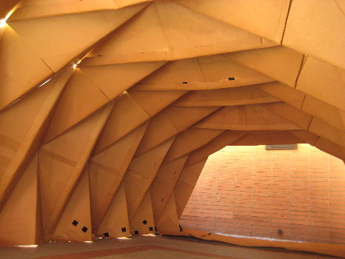
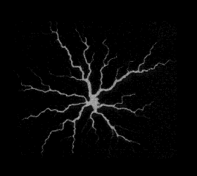
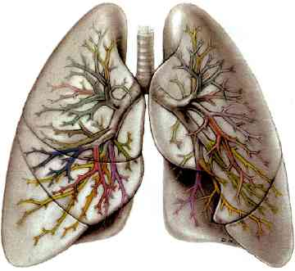
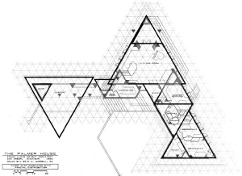
3.2 Applications (miscellaneous)

Slide 12
4. Three “exotic” problems in math
Construct a function on real number that is continuous yet non-derivable everywhere.
Construct a figure with bounded area yet infinite circumference, say in a paper plane.
Construct a set with zero measure yet (uncountably) infinite many points.

Slide 13
5. References
The Fractal Geometry of Nature, Mandelbrot (1982);
Fractal Geometry as Design Aid, Carl Bovill (2000);
Applications of Fractal Geometry to the Player Piano Music of Conlon Nancarrow, Julie Scrivener;
Principles of Mathematical Analysis, Rudin (3rd edition);
http://www.doc.ic.ac.uk/~nd/surprise_95/journal/vol4/ykl/report.html; (Brownian Motion and Fractal Geometry)
http://www.triplepundit.com/2011/01/like-life-sustainable-development-fractal/; (Fractal and Life, leisure taste )
http://users.math.yale.edu/mandelbrot/. (Mr. Mandelbrot)

