Slide 1
OSR
On some interesting Curves...
Aditya Kiran
Grad 1st yr
Applied Math

Slide 2
Curvature
The fact of being curved or the degree to which something is curved..
Tendency to deviate from moving in a straight line..

Slide 3
How to find curvature?
➔ y =f(x) form
➔Parametric form
y =f(t) , x=f(t)
➔ Polar form (r,theta)

Slide 4
4 ‘interesting’ curves
We discuss about 4 curves today:
1)Catenary
2)Tractrix
3)Archimedean Spiral
4) Tautochrone

Slide 5
#1

Slide 6
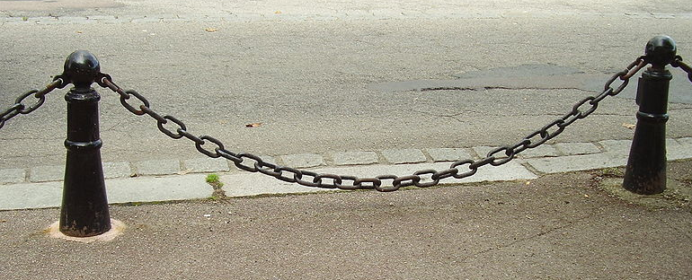
Catenary
Àlso called Alysoid or chain equation..
The word catenary is derived from the Latin word ‘catena’ for chain.
Solved by Huygens (wave theory of light- guy)

Slide 7
equation
Y = Coshx(x/a)
Parametric:
X(t)=t,
Y(t)=aCosh(t/a)
Curvature:
k(t)=

Slide 8
Special properties..
A catenary is also the locus of the focus of a parabola rolling on a straight line.
The catenary is the evolute of the tractrix.

Slide 9
#2

Slide 10
Tractrix
From the Latin ‘trahere’ meaning drag/pull..
Also called drag curve or donkey curve.
The tractrix was first studied by Huygens in 1692

Slide 11
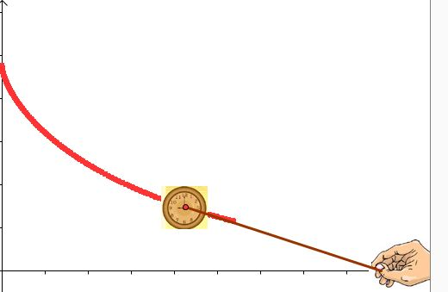
So what’s the problem about?
“What is the path of an object when it is dragged along by a string of constant length being pulled along a straight horizontal line”

Slide 12
The Equation :
Y=a*Sech(t)
X=a*(t-Tanh(t))
Curvature:
k(t)=Cosech(t)/a

Slide 13
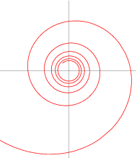
Special properties..
Tractrix is also obtained when a hyperbolic spiral is rolled on a straight line..Then locus of the center of the hyperbola forms a tractrix.
Evolute of a tractrix is a catenary

Slide 14
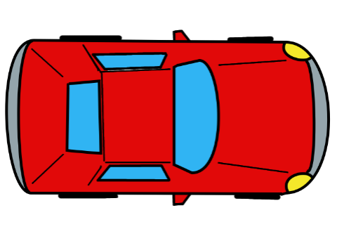
Example in daily life:
..If Car front wheels travel along straight line, the back wheels follow a tractrix.

Slide 15
#3

Slide 16
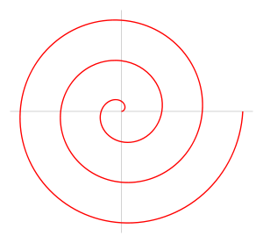
Archimedean spiral
It is the locus of a point moving away from a fixed point with a constant speed along a line which rotates with constant angular velocity.
Rotate around a point with constant angular velocity
Move away from the point with constant speed
Archimedean spiral
=

Slide 17
Equation in polar coordinates:
a➔ turns the spiral
B→ controls the distance between successive turnings.

Slide 18
equation
r= bϴ
Parametric:
x= b*ϴ*Cos(ϴ)
y= b*ϴ*Sin(ϴ)
Curvature:
Any ray from origin meets successive turnings at a constant separation.

Slide 19
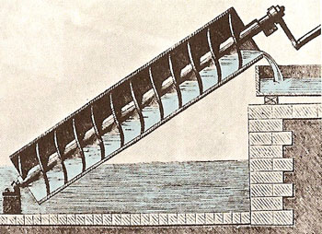
Used to convert circular motion to linear motion..
Used in Archimedes screw

Slide 20
General formula of spiral
X=1, Archimedean spiral
X=2 ,Fermat spiral
X=-1 ,Hyperbolic spiral
Logarithmic spiral➔

Slide 21
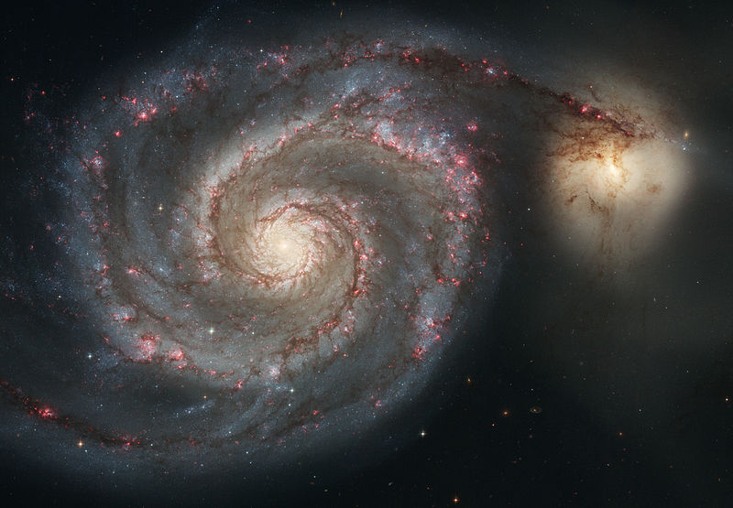
Logarithmic spiral

Slide 22
#4

Slide 23
Tautochrone
A tautochrone or isochrone curve
Tauto=same, and chrono =time
Solved by Christian Huygens in 1659.
“the curve for which the time taken by an object sliding without friction in uniform gravity to its lowest point is independent of its starting point”

Slide 24
Its nothing but a cycloid.
(
Curvature: k=Cosec(ϴ/2)/4a

Slide 25
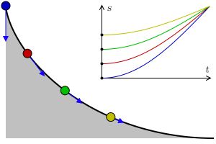
T=

Slide 26
Thank you.!!!

