Slide 1
2D Symmetry & Cayley Tables
Romit Girdhar
MATH 420
10/23/2012

Slide 2

Symmetry
What is symmetry?
Symmetries of a Square
  8 Motions to position a square and still be symmetric
  Motion : Applying a function to the square.
A
B
B
C
R90
C
D
A
D
Disclaimer: Angles will be displayed in degrees and not in radians. (Sorry!)

Slide 3
Cayley Tables
Introduced by English mathematician, Arthur Cayley
Let’s continue with our square
  D₄
  Dihedral group of order 8.
A
B
B
C
A
D
R90
H
C
D
A
D
B
C
Diagonal Motion (D)

Slide 4
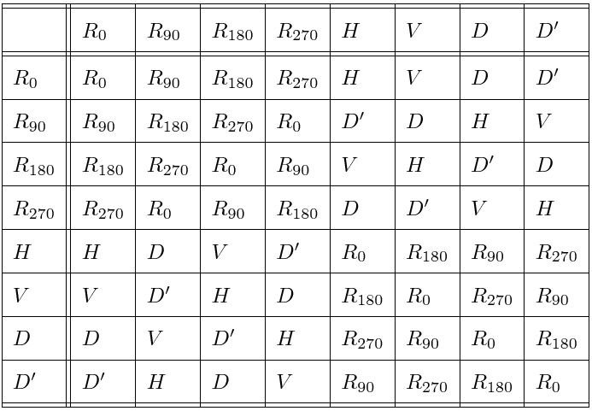
Cayley Tables
Cayley Table for a Square (D₄)

Slide 5
Dihedral Groups
Triangle (D₃)
  6 Motions
  Dihedral group of order 6.
Pentagon (D₅)
  10 Motions
  Dihedral group of order 10.
Do you notice a pattern?
  For any regular n-gon (n >= 3), the group is denoted by D_{n} and is called ‘Dihedral group of order 2n’.

Slide 6
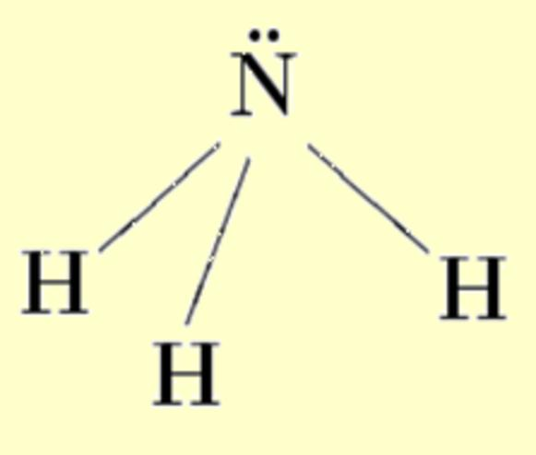


Dihedral Groups
Do we see these in our everyday life?

Slide 7

Questions?

