Slide 1
Platonic Solids
MATH 420 Presentation: Kelly Burgess

Slide 2
What are they?
Convex Polyhedron (polyhedron: 3d solid with straight edges and flat faces)
All faces are congruent
Same number of faces meet at each vertex
Named after Greek philosopher Plato who associated each with a basic "element"
Total of 5

Slide 3
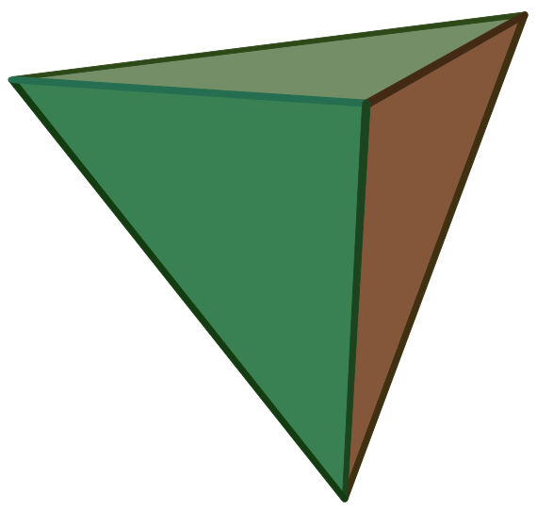
Tetrahedron: Fire
4 vertices
4 faces (triangles)
6 edges
3 faces meet at each vertex

Slide 4
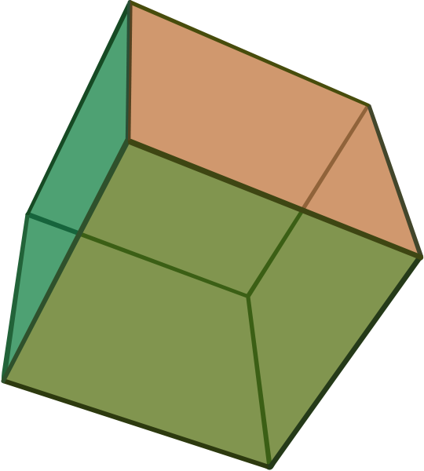
Hexahedron: Earth
8 vertices
6 faces (squares)
12 edges
3 faces meet at each vertex

Slide 5
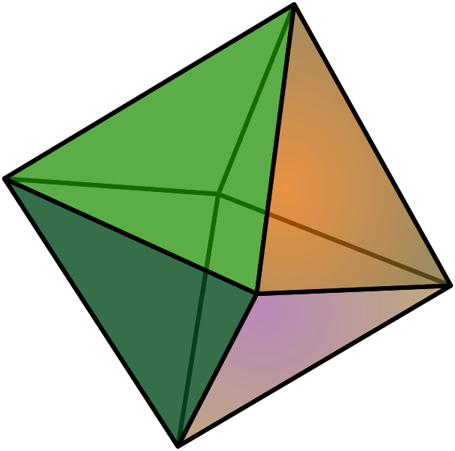
Octahedron: Air
6 vertices
8 faces (triangles)
12 edges
4 faces meet at each vertex

Slide 6
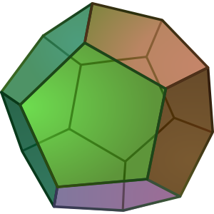
Dodecahedron: Universe
20 vertices
12 faces (pentagons)
30 edges
3 faces meet at each vertex

Slide 7
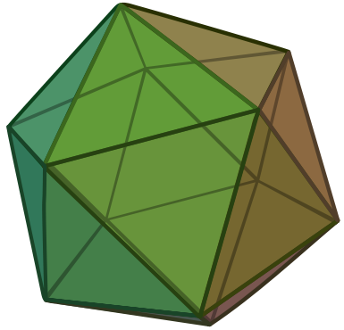
Icosahedron: Water
12 vertices
20 faces (triangles)
30 edges
5 faces meet at each vertex

Slide 8
Relevant Equations!
let V= number of vertices, E= number of edges, F=number of faces
p=number of edges on each face
q=number of faces meeting at each vertex
V-E+F=2 (Euler)
and
pF=2E=qV
Why are there only 5 Platonic Solids?

