Slide 1
Biomedical Engineering and Geometry
Results of a Google search
Tim Bryski – 9/11/12

Slide 2
Exploration trail
BLOW
YOUR
MIND!
Cool
Fun

Slide 3
How do viruses effect us?
Several viruses that effect humans are
Rhinoviruses (common cold)
Orthomyxoviridae (Influenza)
Rhabdoviridae (Rabies)
Hepadnaviridae (Hepatitis B)
Flaviviridae (Yellow Fever)

Slide 4
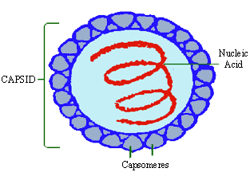
Virus Structure
A simple virus contains nucleic acid and a capsid
The nucleic acid is normally RNA or DNA
The capsid is made up of proteins.
http://www.pinkmonkey.com/studyguides/subjects/biology-edited/chap14/b1400001.asp

Slide 5
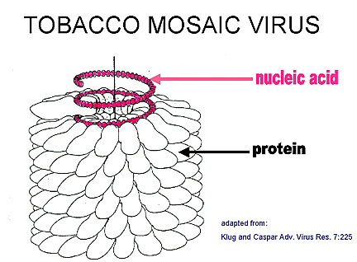
Capsid structure
In a simple virus the capsid is created from a tiling of one type of protein
Because of the size of a virus, the nucleic acid can only code for several proteins maximum
The capsid can contain one or two layers of proteins
http://pathmicro.med.sc.edu/int6.jpg

Slide 6
Theoretical Problem
We need to know all possible configurations of the capsid in order to design effective anti-viral therapy.
Experimental evidence alone can not effectively give us every possible capsid structure
We need a mathematical theory that will allow us to predict the number and types of capsids for each virus

Slide 7
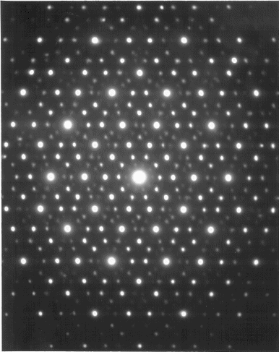
Trans Electron Microscopy
X-ray diffraction crystallography – Watson & Crick
“[viruses] can be considered a ‘molecule’ in the sense used by protein crystallographers—an entity, the major part of which has its atoms arranged in definite (relative) positions in space.
Ewald Construction
http://www.lassp.cornell.edu/lifshitz/quasicrystals.html

Slide 8
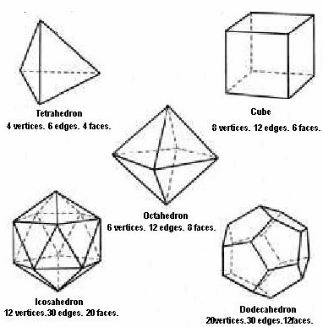
Platonic Solids
http://jwilson.coe.uga.edu/EMAT6680/Parveen/platonic_solids.htm

Slide 9
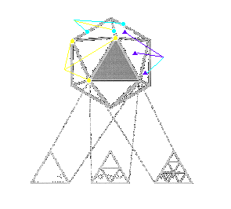
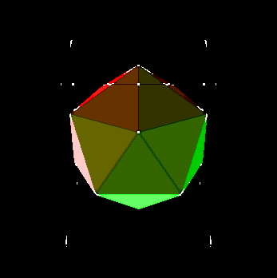
Caspar-Klug Theory
Studied simple viruses with Icosahedral shaped capsids
Used triangulation to predict the shape and position of proteins in the capsid
T=Pf ²
P=h²+hk+k²
Increases in f from 1 ⬆ correspond to
successive subtriangulations
http://www.tulane.edu/~dmsander/WWW/335/335Structure.html

Slide 10
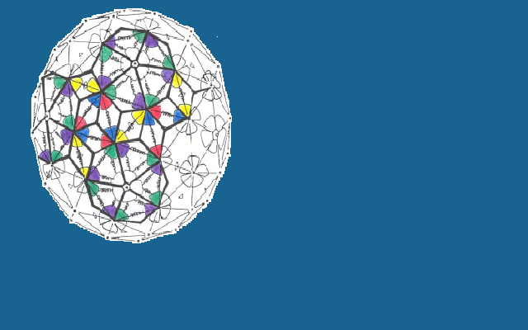
Twarock 2004
Relaxed the assumption of triangular shaped subunits of proteins
Re-evaluated the family of Icosahedral shaped capsids
Uses tiling theory to determine the structure of the capsid

Slide 11
Tiling Theory
  Definitions
Tilings- tessellations in terms of a set of basic building blocks
Decorations- Location of protein subunits on tiles
Plane tiling(T)- countable family of closed sets which cover the plane without gaps or overlaps
Simply connected- tile does not enclose any holes
Topological disk- bounded, connected and simply connected set
Patch- finite number of tiles of the tiling such that their union is a topological disk
Incident- the relation of a tile to each of its edges or vertices and also of an edge to each of its endpoints

Slide 12
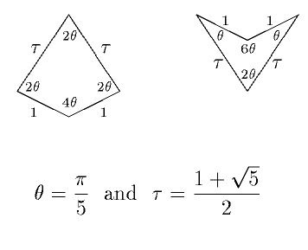
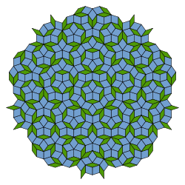
Tiling — The Mathematical Microscope?
http://www.lassp.cornell.edu/lifshitz/quasicrystals.html
Penrose tiling
http://en.wikipedia.org/wiki/Penrose_tiling

Slide 13
Affine Geometry
Whilst predicting the relative locations of proteins is “easy”, information on their tertiary structure is hard to get.
Mathematical framework based on affine extentions of the icosehdral group
Allows 3D model
Erlangen Program
(1872 Felix Klein)
Symmetry of groups
Euclidean geometry more restrictive than affine geometry

Slide 14
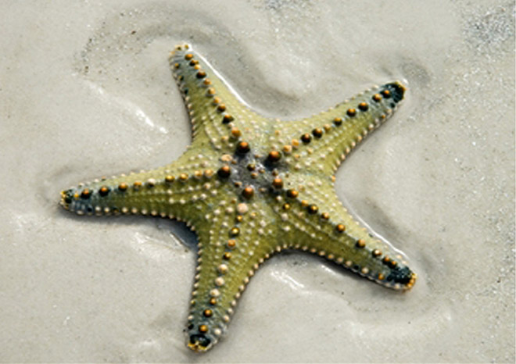
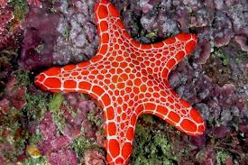
Dihedral Groups
Often arise in art and nature
A dihedral group is the group of symmetries of a regular polygon, including both rotations and reflections
Phylum Echinodermata (starfish, sand dollars, and sea cucumbers) exhibit patterns with D₅ symmetry.

Slide 15
Resources:
D. L. D. Caspar and A. Klug; Physical Principles in the Construction of Regular Viruses ; Cold Spring Harbor Symposia on Quantitative Biology, Volume XXVII, 1962
Fighting Infections With Symmetry; Institute of Mathematics & its Applications
R. Twarock; A tiling approach to virus capsid assembly explaining a structural puzzle in virology; Journal of Theoretical Biology, 226 (2004), 477 – 482
T. Keef and R. Twarock; Affine extensions of the icosahedral group with applications to three-dimensional organisation of simple viruses
T. Keef and R. Twarock; Viruses and geometry - where symmetry meets function; Microbiology Today (Feb. 2010) 24 – 27
F. H. C. Crick and J. D. Watson; Structure of small viruses; Nature 4506 (Mar. 10, 1956) 473 – 475
J. A. Gallian; Contemporary Abstract Algebra (8th) 34 – 36

